Slide 1
Radiology every doctor should know
Radiology Jeopardy
Original by Shanna Matalon
Revised by Liwei Jiang
Template courtesy of Dr. Petra Lewis, Dartmouth-Hitchcock Medical Center
Notes:
Revised on 5/21/2018

Slide 2
The Rules

Slide 3
2-3 teams will compete
The team that “has the board” will select the category and points
If you wish to take the question, raise your hand
I will indicate which team was first
Answers can then be discussed between team members
You have 10 seconds to answer before the next team is given the question.
If you pass a question or give an incorrect answer, your team loses the points and then the other groups have a chance to answer

Slide 4
8. BIG money prizes to the winning team…

Slide 5
My
decision is final
(even if wrong)

Slide 6
Radiology Jeopardy
Chest
200
MSK
GI/GU
300
400
500
100
200
300
400
500
100
200
300
400
500
Neuro
100
200
300
400
500
100
Patient Management and Safety
100
200
300
400
500
Notes:
Change these headings to any you wish, also change heading slides 11,33,55,77,99 to match to save confusion

Slide 7
Double Jeopardy
Chest
400
MSK
GI/GU
600
800
1000
200
400
600
800
1000
200
400
600
800
1000
Pediatric/ Obstetric Imaging
200
400
600
800
1000
200
Patient Management and Safety
200
400
600
800
1000
Notes:
Change these headings to any you wish, they can be different from the prior categories, also change heading slides 22,44,66,88,110 to match to save confusion

Slide 8
Final Jeopardy

Slide 9
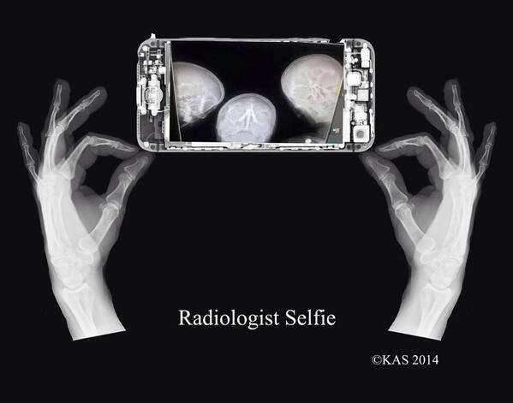
The End

Slide 10
Chest
Notes:
Or other category of your wish for single jeopardy

Slide 11
100 Points
What structure forms this border?

Slide 12
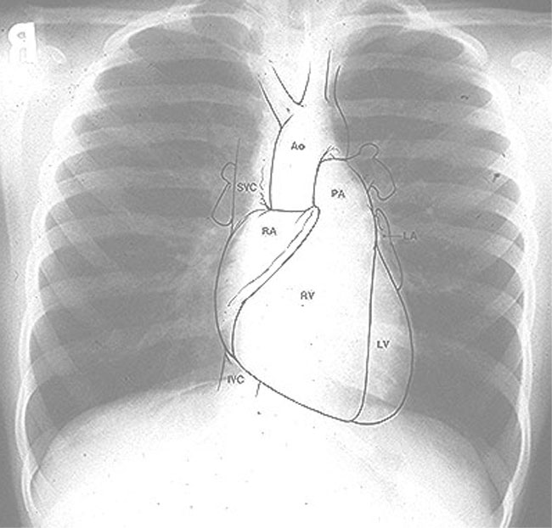
Answer 100 Points
Right Atrium

Slide 13
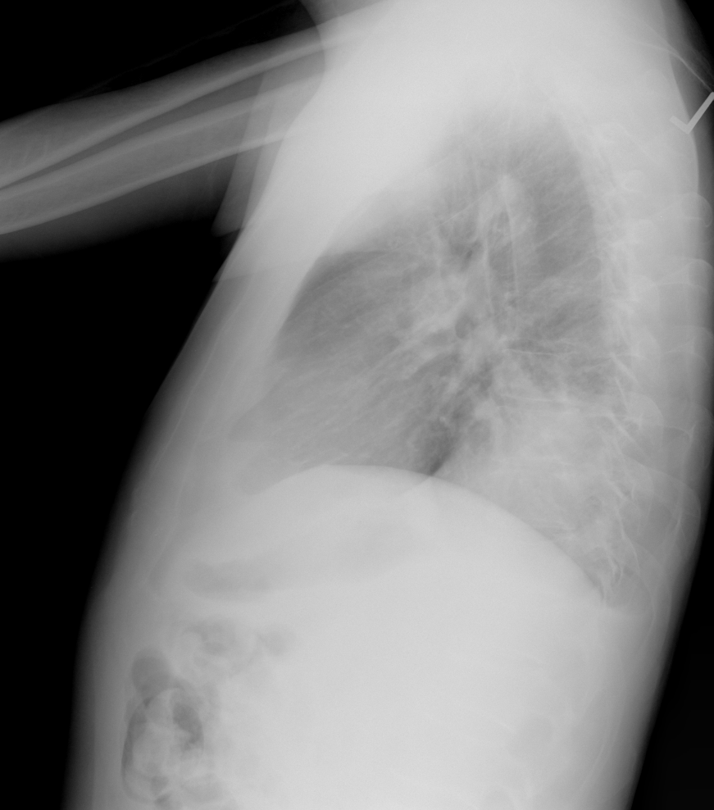
200 Points
What is the name of this sign and what does it signify?

Slide 14
Answer 200 Points
Spine Sign.
Consolidation of a lower lobe.

Slide 15
300 Points
What does this sign on CXR represent?

Slide 16
Answer 300 Points
CHF/Pulmonary Vascular Congestion
(Kerley B Lines)

Slide 17
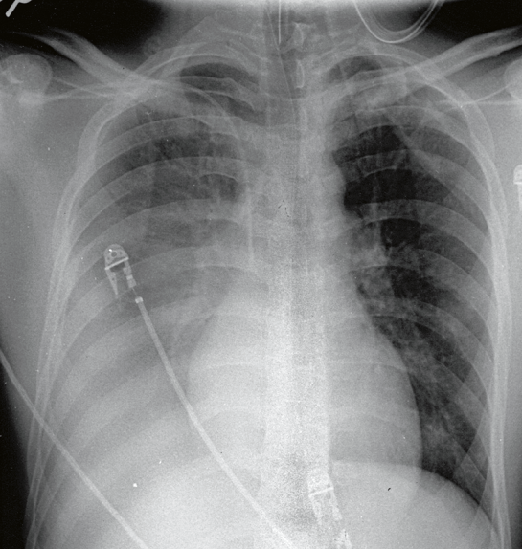
400 Points
What causes the silhouette sign?

Slide 18
Answer 400 Points
When 2 structures of a similar density touch, you lose the expected border

Slide 19
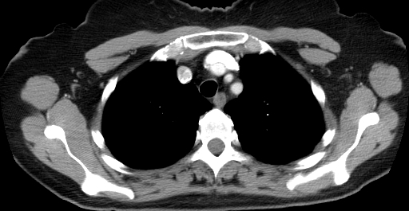
500 Points
Name these 3 structures in correct order.

Slide 20
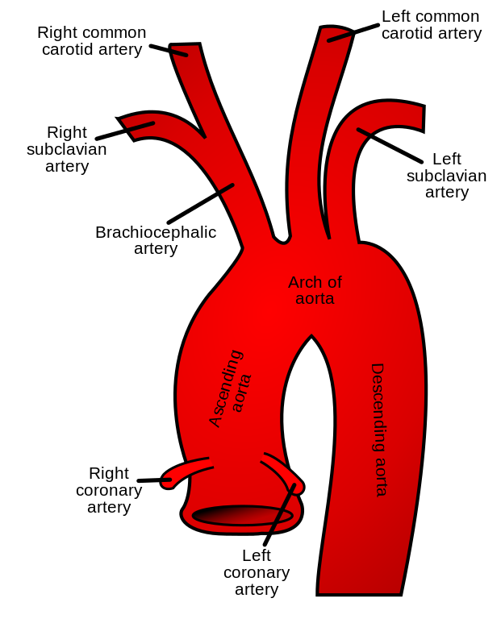
Answer 500 Points
Brachiocephalic artery
Left common carotid artery
Left subclavian artery

Slide 21
Chest
Notes:
Or other category of your wish for double jeopardy

Slide 22
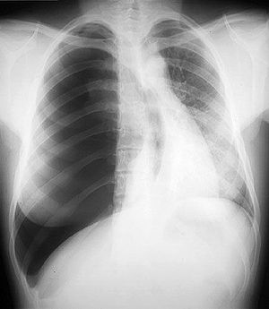
200 Points
What is most likely diagnosis
www.medrevise.co.uk

Slide 23
Answer 200 Points
Tension pneumothorax

Slide 24
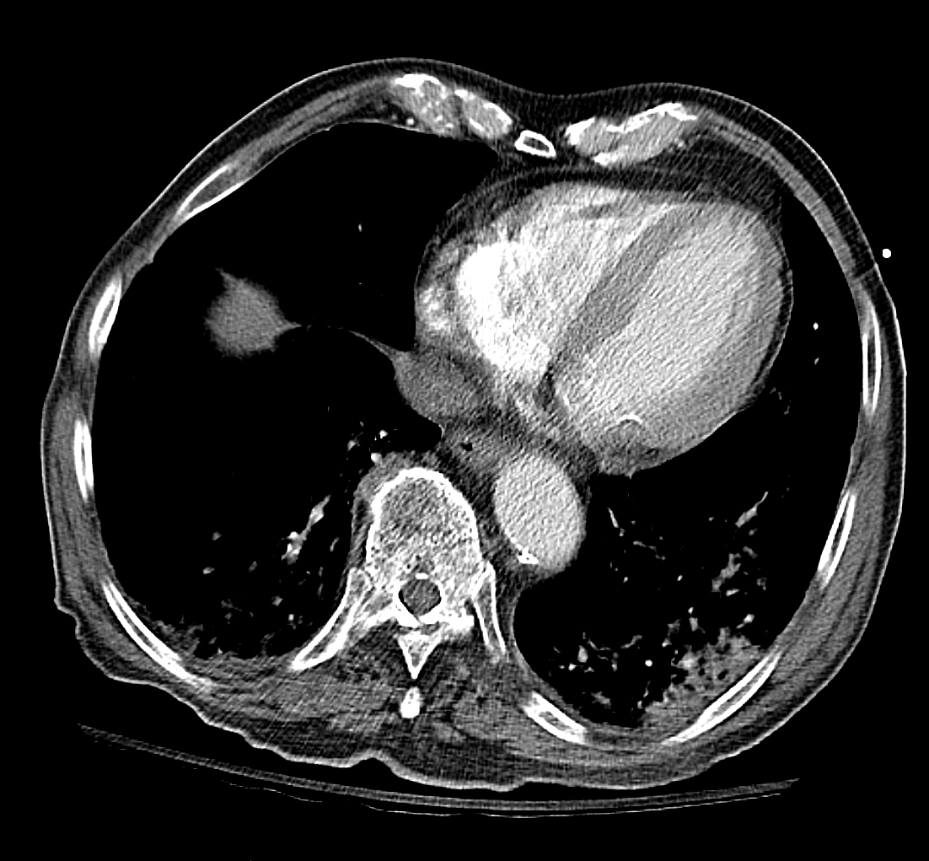
400 Points
What structure is labeled with the star

Slide 25
Answer 400 Points
Right Ventricle

Slide 26
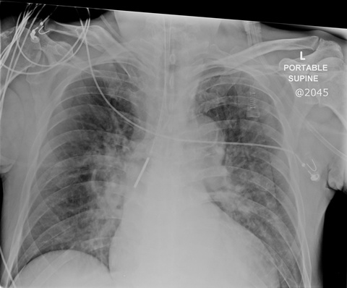
600 Points
What is the most concerning finding on this chest x-ray
www.lhsc.on.ca

Slide 27
Answer 600 Points
Feeding tube in right mainstem bronchus

Slide 28
800 Points
Name 2 causes of a radiopaque hemithorax (“white-out” of a lung)

Slide 29
Answer 800 Points
Pneumonectomy, Total lung collapse, Pleural effusion, Diaphragmatic hernia, Large pleural mass, severe ARDS, Consolidation of lung

Slide 30
1000 Points
Name 3 signs of aortic injury on chest radiography

Slide 31
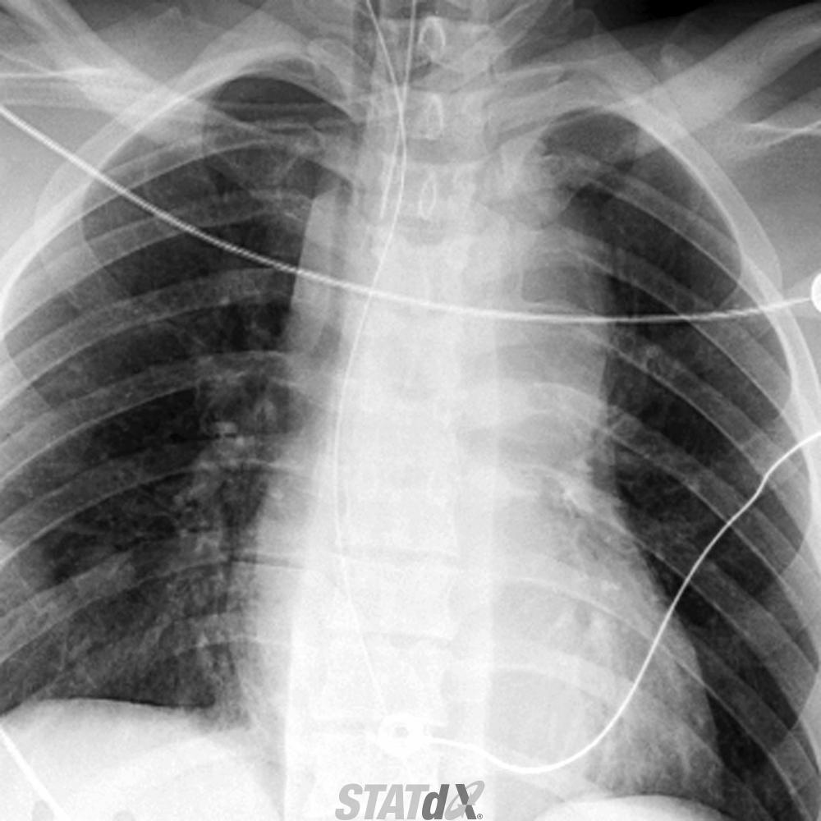
Answer 1000 Points
Thickened right paratracheal stripe, Left apical capping, Indistinctness of aortic knob

Slide 32
MSK
Notes:
Or other category of your wish for single jeopardy

Slide 33
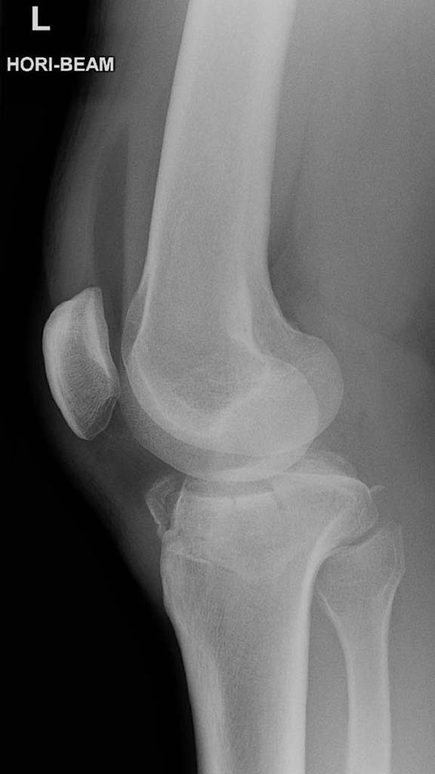
100 Points
What does the presence of a fat fluid level within a joint indicate
Case courtesy of Dr Donna D'Souza, Radiopaedia.org, rID: 7507

Slide 34
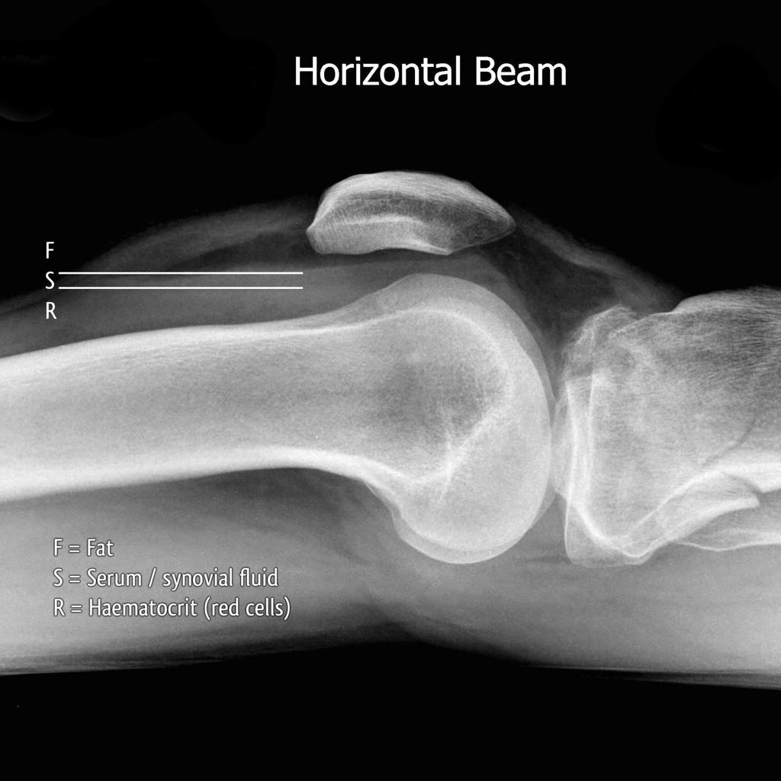
Answer 100 points
Lipohemarthrosis: Intra-articular fracture
Case courtesy of Dr Jeremy Jones, Radiopaedia.org, rID: 6861

Slide 35
200 Points
What is the best initial test for evaluating for a fracture

Slide 36
Answer 200 points
Radiography

Slide 37
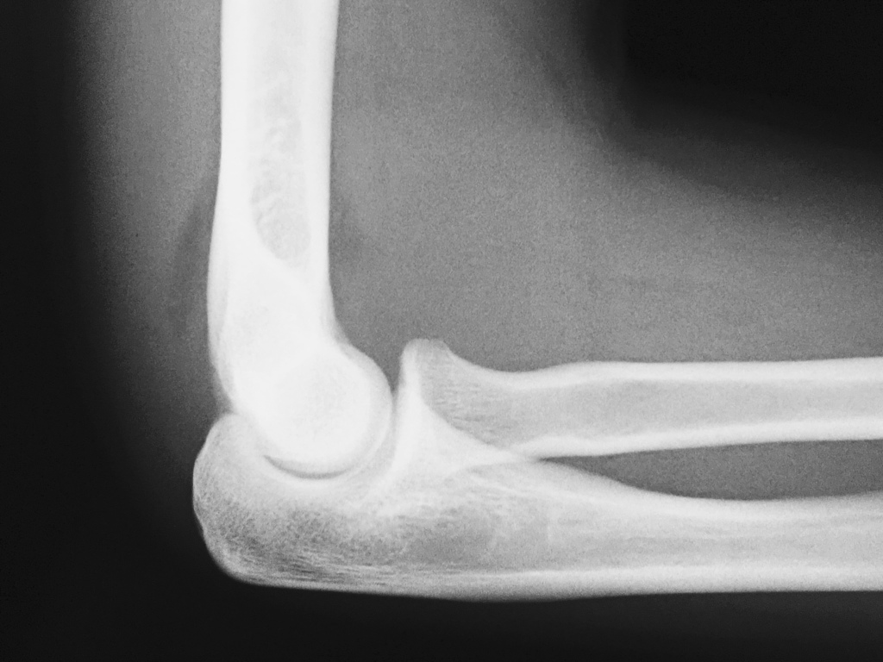
300 Points
The presence of which fat pad on a true lateral elbow film is ALWAYS abnormal
Case courtesy of Dr Ian Bickle, Radiopaedia.org, rID: 59706

Slide 38
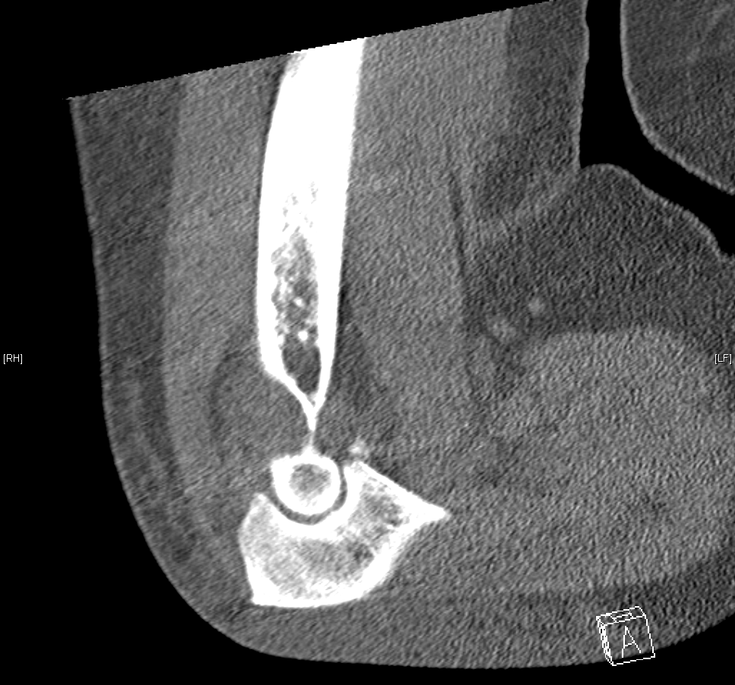
Answer 300 points
Posterior fat pad

Slide 39
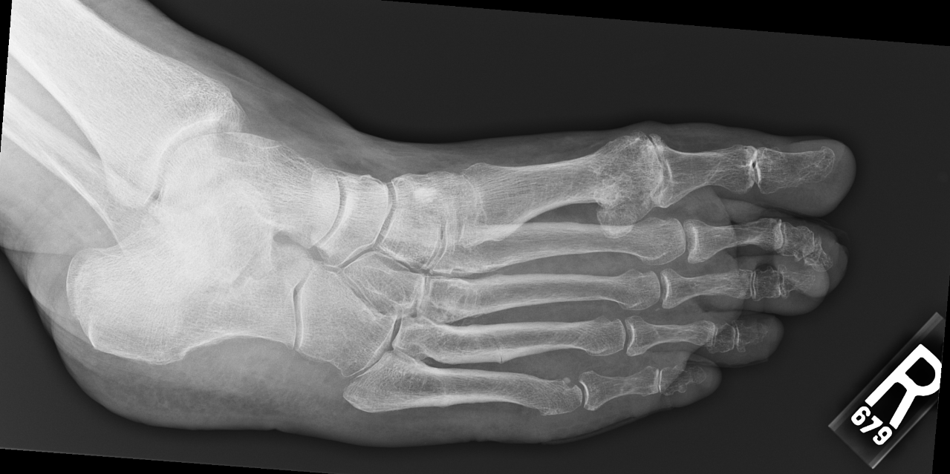
400 Points
Name the bone with a star on it

Slide 40
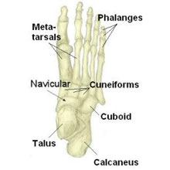
Answer 400 points
Cuboid

Slide 41
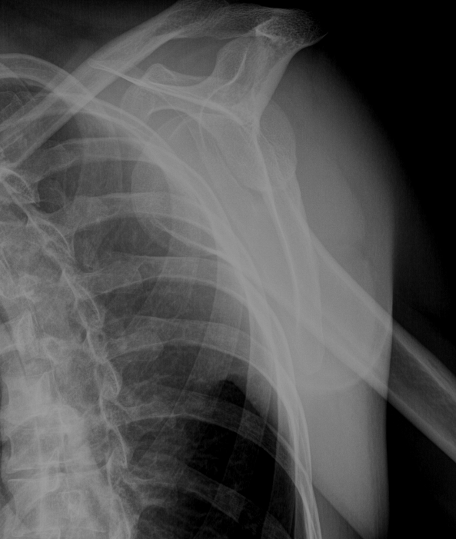
500 Points
What is the most likely diagnosis

Slide 42
Answer 500 points
Anterior shoulder dislocation

Slide 43
MSK
Notes:
Or other category of your wish for double jeopardy

Slide 44
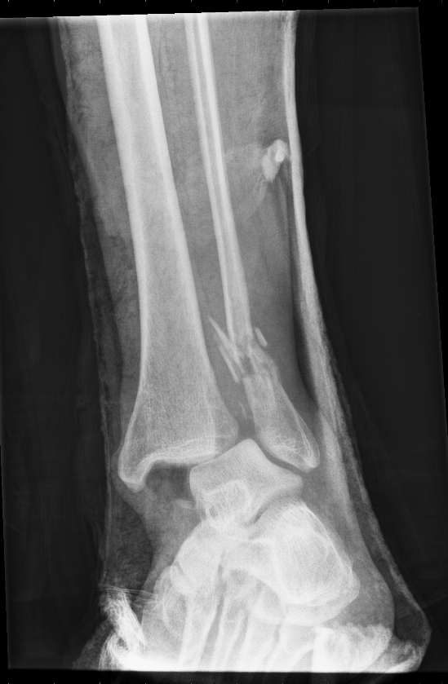
200 Points
Please describe the findings

Slide 45
Answer 200 Points
Comminuted distal fibular fracture.
Tibiotalar dislocation (widening of medial clear space)

Slide 46
400 Points
What is the best first imaging test in suspected bone tumor

Slide 47
Answer 400 Points
Radiograph

Slide 48
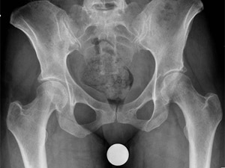
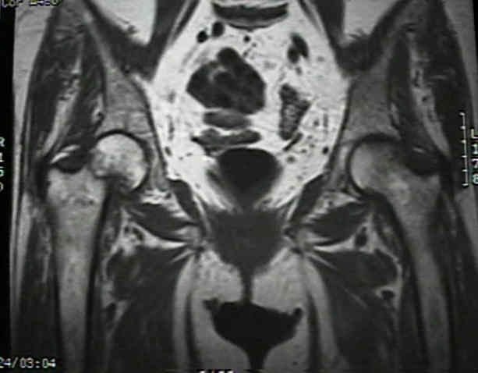
600 Points
What is the most likely diagnosis
www.wheelessonline.com

Slide 49
Answer 600 Points
Occult Hip Fracture

Slide 50
800 Points
What physiologic process is being imaged in this test

Slide 51
Answer 800 Points
New bone deposition
Bone scintigraphy using Tc-99m–labeled diphosphonates

Slide 52
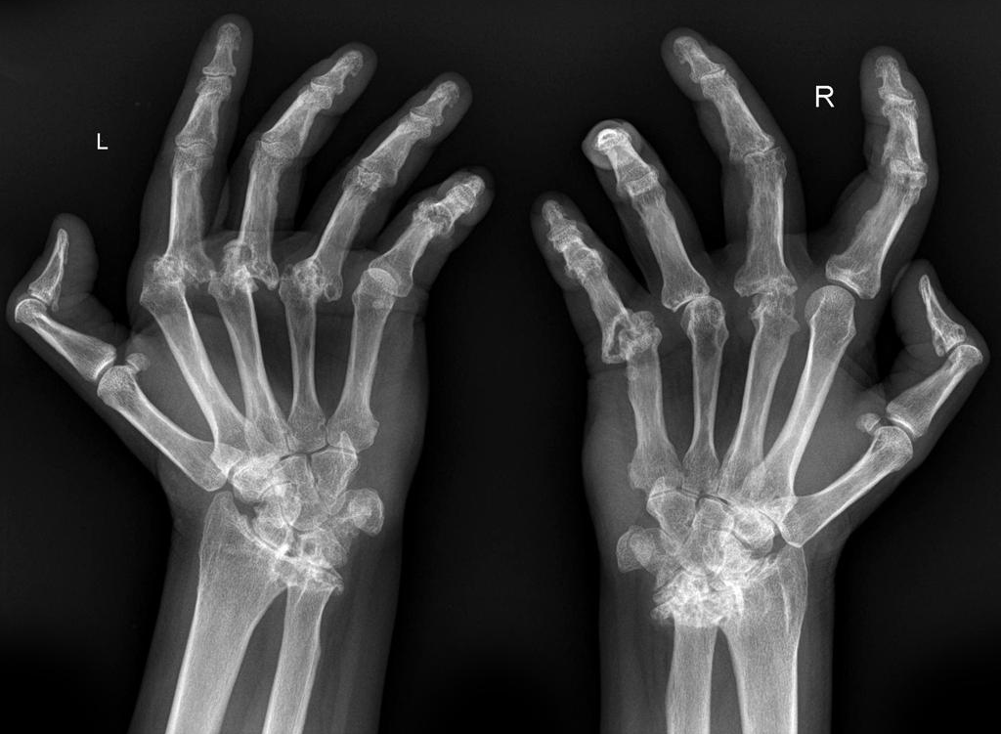
1000 Points
What is the most likely diagnosis
Case courtesy of A.Prof Frank Gaillard, Radiopaedia.org, rID: 7245

Slide 53
Answer 1000 Points
Rheumatoid Arthritis

Slide 54
GI/GU
Notes:
Or other category of your wish for single jeopardy

Slide 55
100 Points
What is the most likely diagnosis

Slide 56
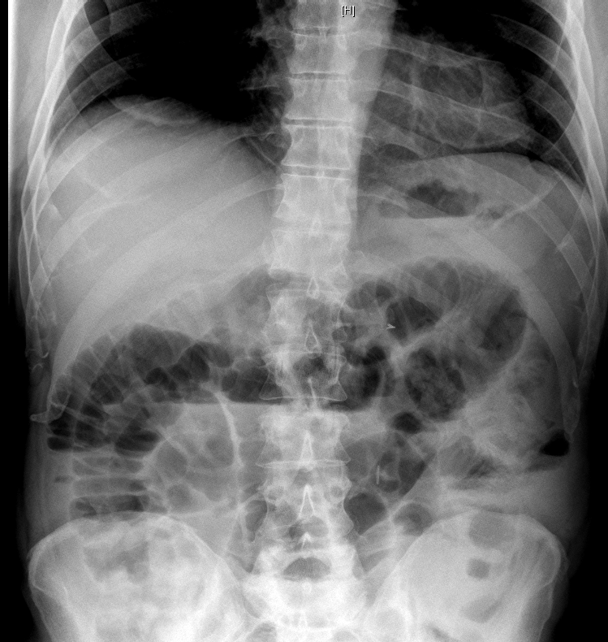
Answer 100 Points
Small Bowel Obstruction
(will also accept ileus)

Slide 57
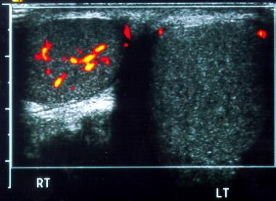
200 Points
What is the most likely patient presentation
emedicine.medscape.com

Slide 58
Answer 200 Points
Unilateral scrotal pain secondary to testicular torsion

Slide 59
300 Points
What is the most sensitive plain radiographic exam to look for free air in the abdomen?

Slide 60
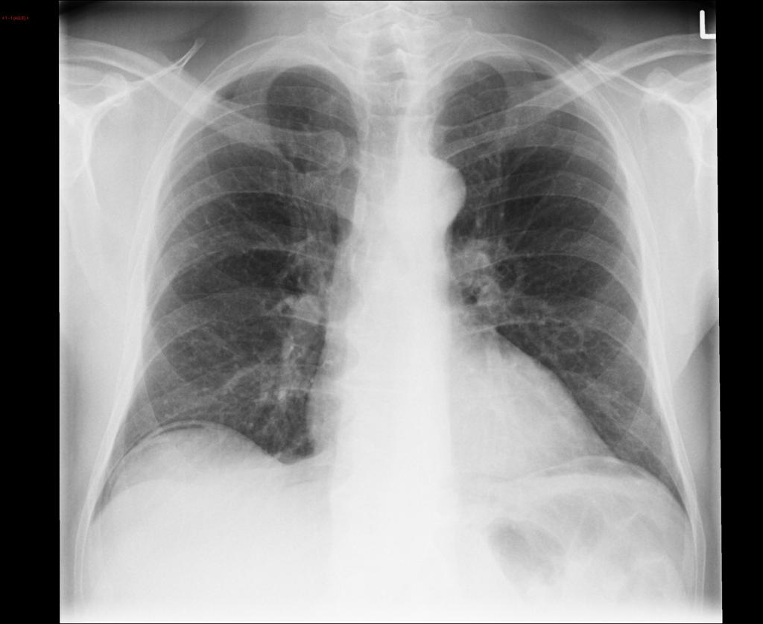
Answer 300 POINTS
Upright chest radiograph
Case courtesy of Dr Sajoscha Sorrentino, Radiopaedia.org, rID: 14866

Slide 61
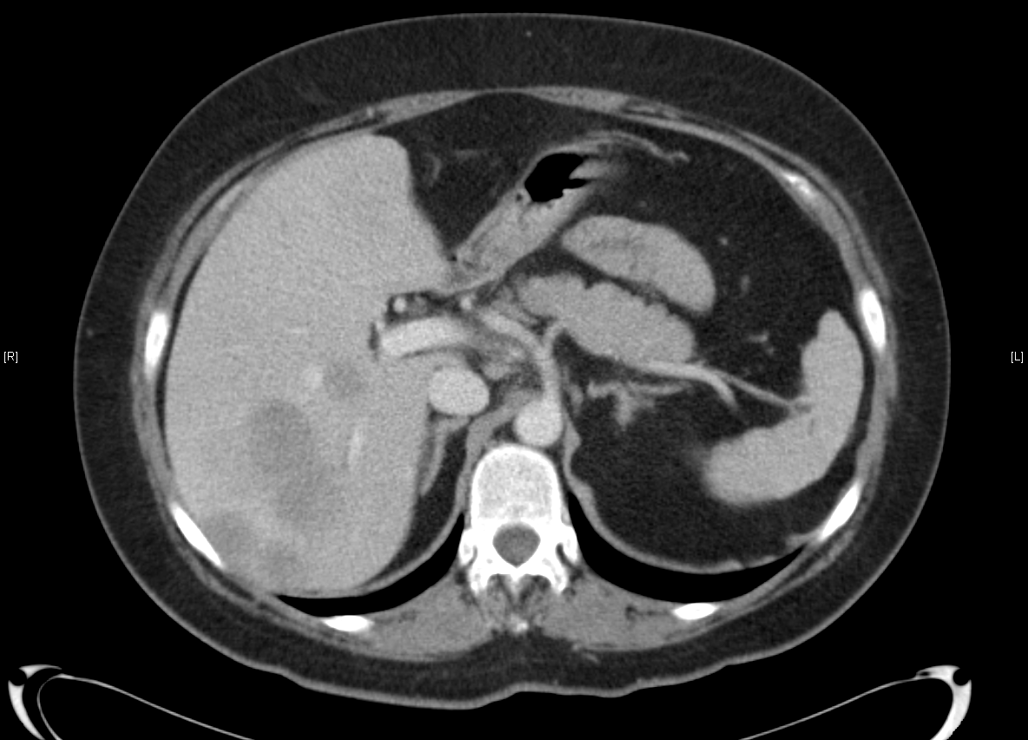
400 Points
What structure is indicated on this CT scan

Slide 62
Answer 400 Points
Pancreas (Tail)

Slide 63
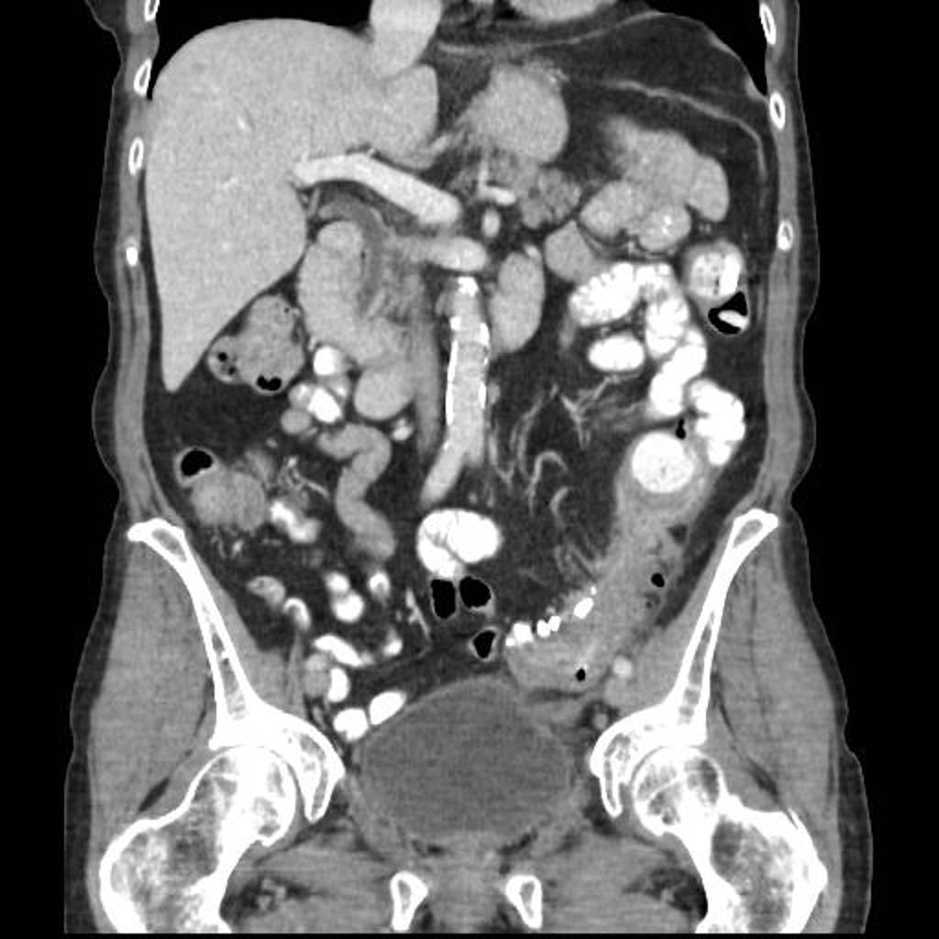
500 POINTS
What is the most likely diagnosis?
Case courtesy of Dr Jeremy Jones, Radiopaedia.org, rID: 14303

Slide 64
Answer 500 Points
Acute Diverticulitis
Case courtesy of Dr Jeremy Jones, Radiopaedia.org, rID: 14303

Slide 65
GI/GU
Notes:
Or other category of your wish for double jeopardy

Slide 66
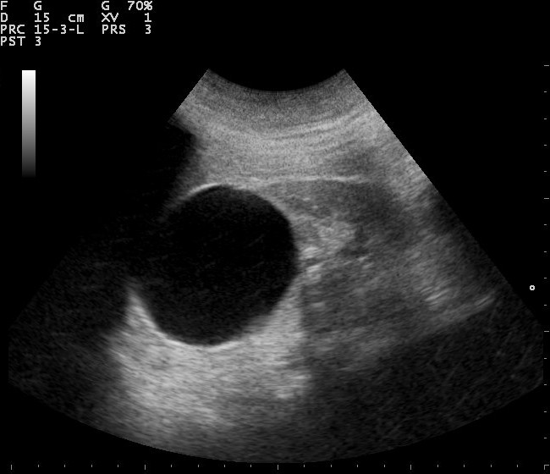
200 Points
What is the most likely diagnosis
commons.wikimedia.org

Slide 67
Answer 200 Points
Simple Renal Cyst
commons.wikimedia.org

Slide 68
400 Points
What is the most sensitive test for detecting a renal calculus?

Slide 69
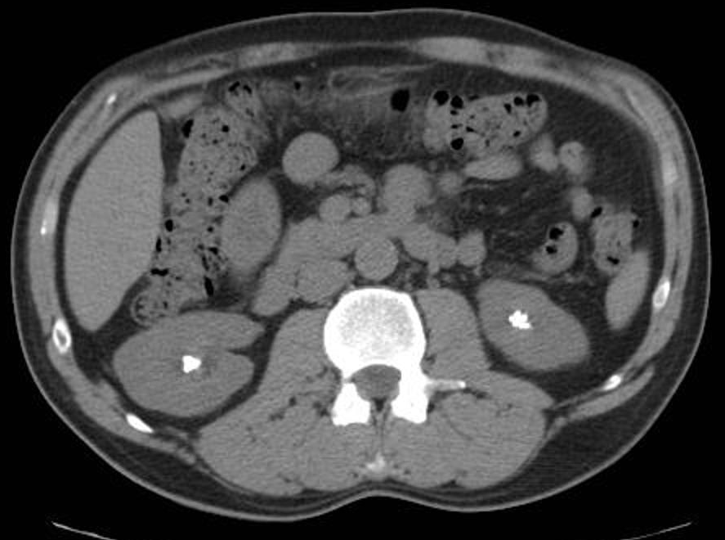
Answer 400 Points
Non-contrast CT of the abdomen/pelvis
Case courtesy of Dr Jeremy Jones, Radiopaedia.org, rID: 6211

Slide 70
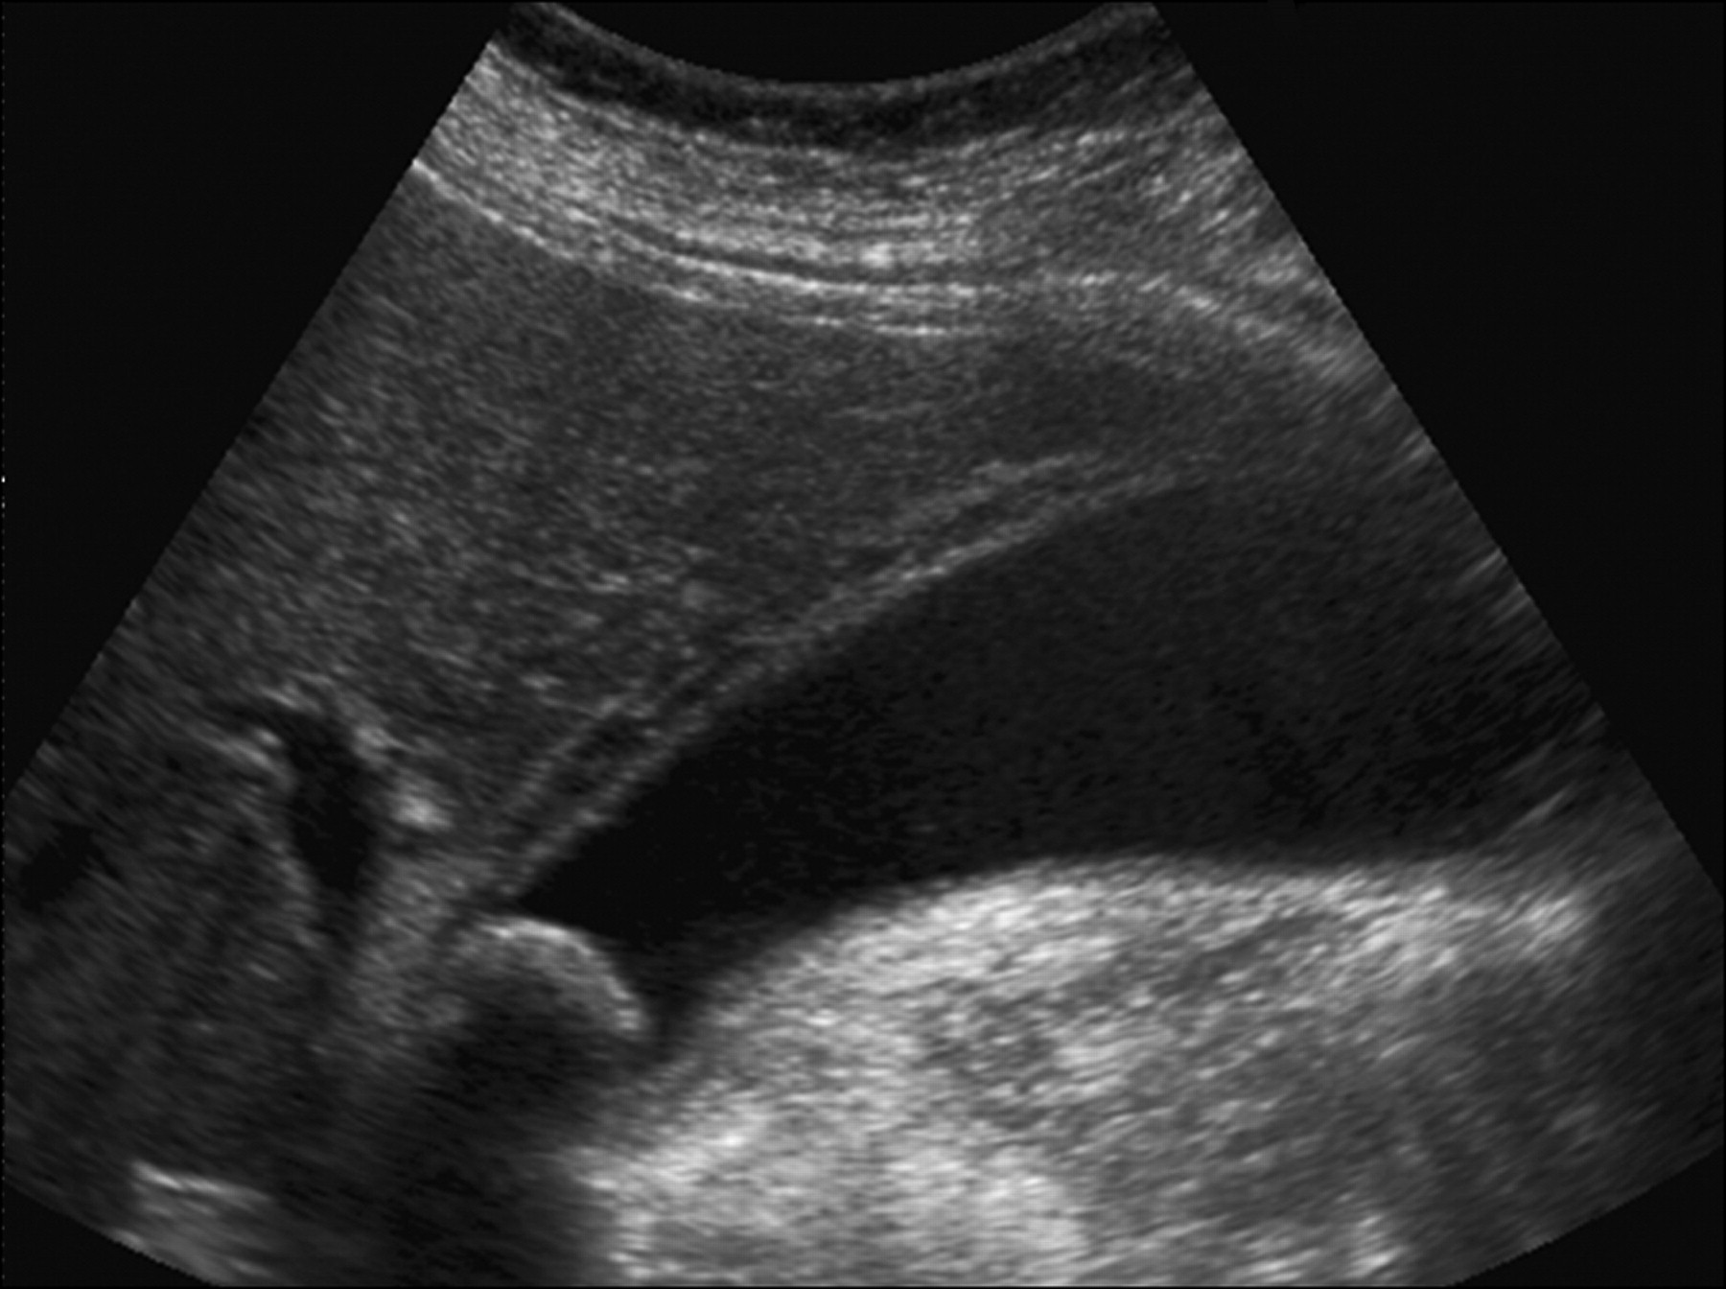
600 Points
What is the most likely diagnosis
www.jultrasoundmed.org

Slide 71
Answer 600 Points
Acute Cholecystitis
www.jultrasoundmed.org

Slide 72
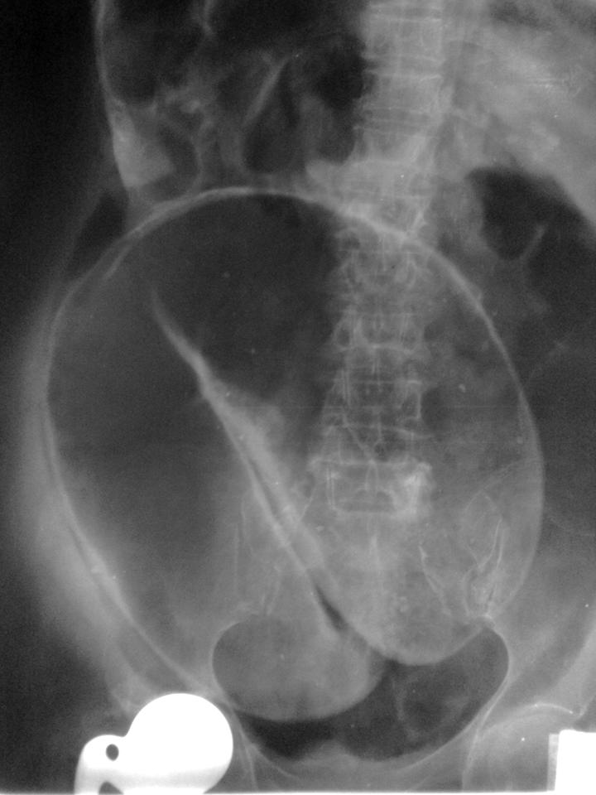
800 Points
What is the most likely diagnosis
Radiopaedia.org

Slide 73
Answer 800 Points
Sigmoid Volvulus

Slide 74
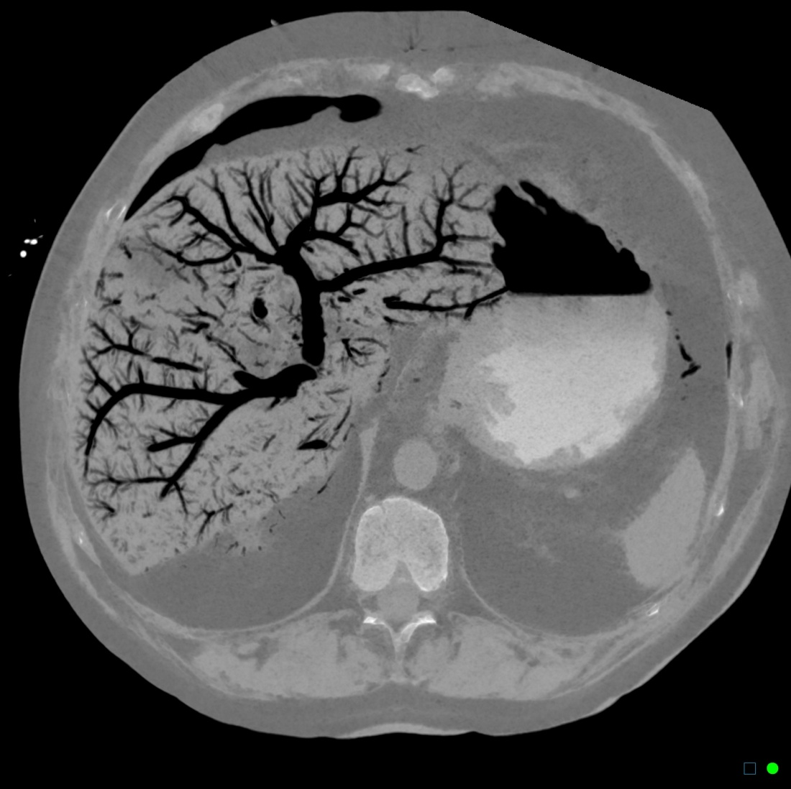
1000 Points
What is the most likely cause of the finding seen on this CT scan
Radiopaedia.org

Slide 75
Answer 1000 Points
Bowel ischemia
(pneumatosis intestinalis)
Radiopaedia.org

Slide 76
Neuro
Notes:
Or other category of your wish for single jeopardy

Slide 77
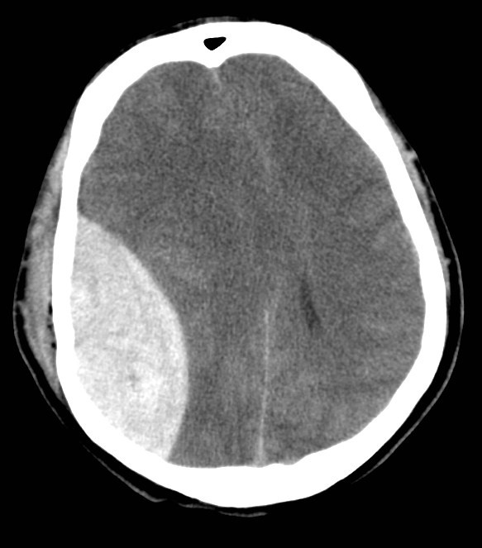
100 Points
What is the most likely diagnosis?
Radiopaedia.org

Slide 78
Answer 100 Points
Epidural hematoma
Radiopaedia.org

Slide 79
200 Points
What are the two MRI sequences shown?

Slide 80
Answer 200 Points
Fluid attenuation inversion recovery (FLAIR)
T1 weighted

Slide 81
300 Points
What MRI sequence is most sensitive for detecting acute stroke?

Slide 82
Answer 300 Points
Diffusion Weighted Imaging (DWI)
Case courtesy of Dr Bruno Di Muzio, Radiopaedia.org, rID: 38608

Slide 83
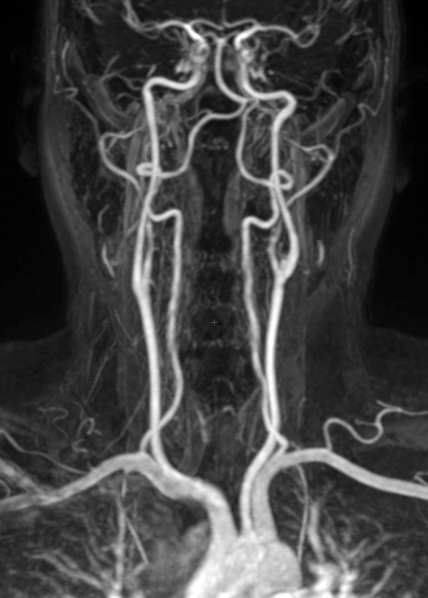
400 Points
Name the structure that is indicated by the arrow
Radiopaedia.org

Slide 84
Answer 400 points
Right Vertebral Artery

Slide 85
500 Points
Name 1 kind of brain herniation that may be caused by a large mass in the posterior fossa

Slide 86
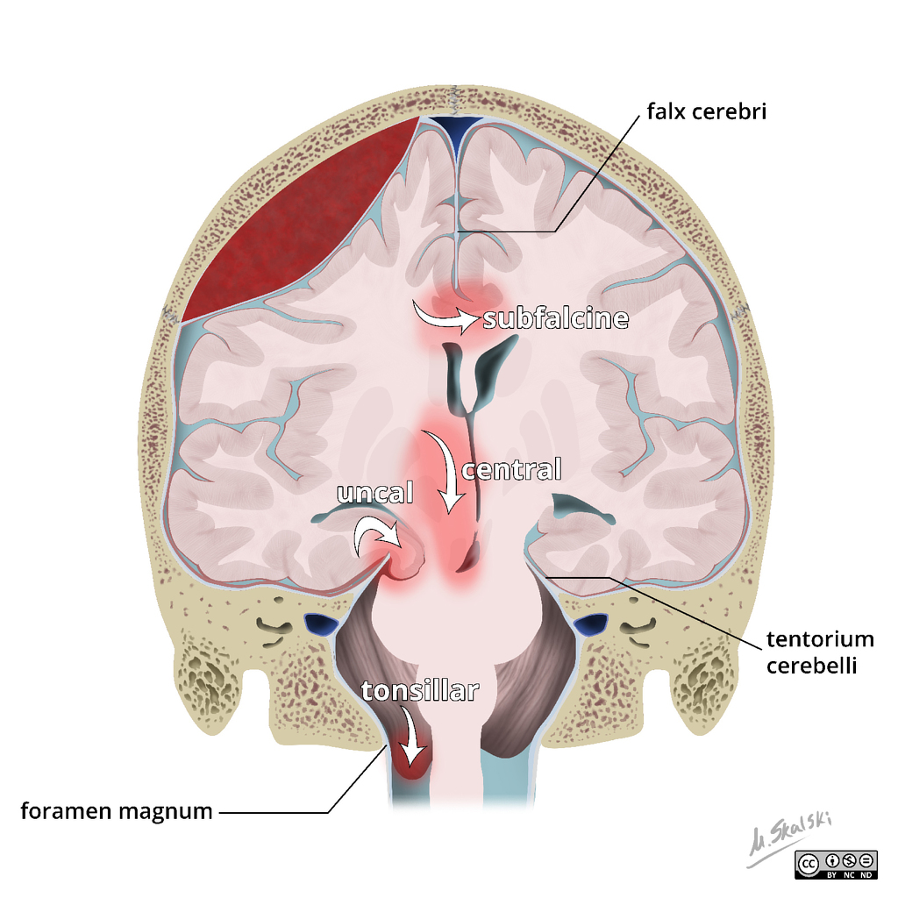
Answer 500 Points
Upward Transtentorial, Tonsillar
Case courtesy of Dr Matt Skalski, Radiopaedia.org, rID: 45683

Slide 87
Pediatric/Obstetric Imaging
Notes:
Or other category of your wish for double jeopardy

Slide 88
200 Points
Name 2 radiographic findings associated with child abuse

Slide 89
Answer 200 Points
Classic metaphyseal lesions (AKA bucket handle or corner fractures), Subdural hematoma of differing ages, Posterior rib fractures, Fractures of different ages

Slide 90
400 Points
Flank pain in a pregnant patient is best evaluated with what modality

Slide 91
Answer 400 points
Ultrasound

Slide 92
600 Points
What is the best way to evaluate right lower quadrant pain in a child?

Slide 93
Answer 600 Points
Ultrasound

Slide 94
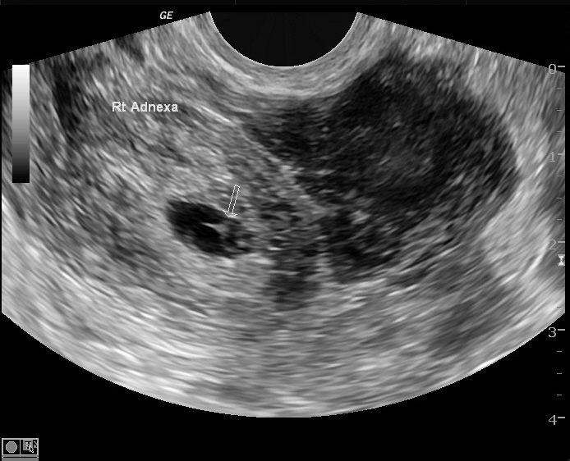
800 Points
What is the most likely diagnosis
Radiopaedia.org

Slide 95
Answer 800 Points
Ectopic Pregnancy
Radiopaedia.org

Slide 96
1000 Points
What structures can be seen in on a first trimester transvaginal ultrasound at 5.5 weeks?

Slide 97
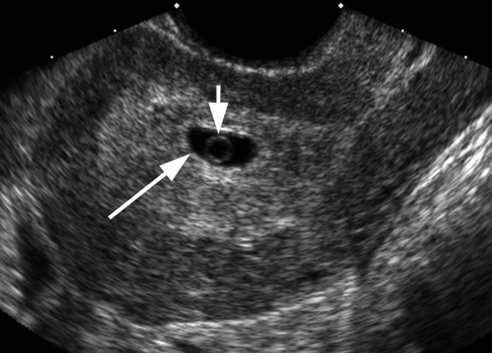
Answer 1000 Points
Gestational sac (5 weeks)
Yolk sac (5.5 weeks)
Embryo not seen until 6 weeks
Callen's Ultrasonography in Obstetrics and Gynecology

Slide 98
Patient Management and Safety
Notes:
Or other category of your wish for single jeopardy

Slide 99
100 Points
What imaging study would you request to evaluate suspected cerebral hemorrhage (be specific)

Slide 100
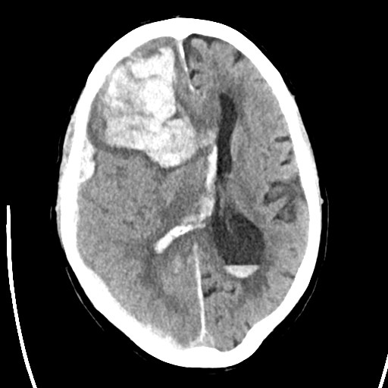
Answer 100 Points
Non-contrast CT of the head
Liwei Jiang, Brigham and Women’s Hospital
Notes:
MRN: 25099409. Patient Had facial droop. Wife swore that his face always looked like that.

Slide 101
200 Points
Name 2 risk factors for adverse reactions to iodinated contrast

Slide 102
Answer 200 Points
Prior contrast allergy
Asthma
Renal insufficiency
Severe cardiac disease
Anxiety
(ACR Manual on Contrast Media 2017: Topic 4)

Slide 103
300 Points
What safety precaution should be taken with any woman of childbearing age before performing any test using ionizing radiation?

Slide 104
Answer 300 Points
Ask if she is or could be pregnant before performing test

Slide 105
400 Points
What is the best first test in the evaluation of right upper quadrant pain?

Slide 106
Answer 400 Points
Right upper quadrant ultrasound

Slide 107
500 Points
What is the best imaging test for a female under 40 years of age with a newly palpable breast lump?

Slide 108
Answer 500 Points
Breast Ultrasound
Relatively dense breast tissue in young women reduces sensitivity of mammography

Slide 109
Patient Management and Safety
Notes:
Or other category of your wish for double jeopardy

Slide 110
200 Points
Aside from a fetus, this segment of the population is most sensitive to radiation

Slide 111
Answer 200 Points
Children

Slide 112
400 Points
What is the most commonly used imaging test to evaluate for metastases to liver (be specific)

Slide 113
Answer 400 Points
Contrast enhanced CT of the abdomen

Slide 114
600 Points
Aside from patient ID, what is the most important information for a referring provider to give to the radiologist?

Slide 115
Answer 600 Points
A good history

Slide 116
800 Points
What is the best next step after seeing a new mass on a screening mammogram

Slide 117
Answer 800 Points
Callback for additional imaging

Slide 118
1000 Points
What imaging test should be done for a suspected coccyx fracture

Slide 119
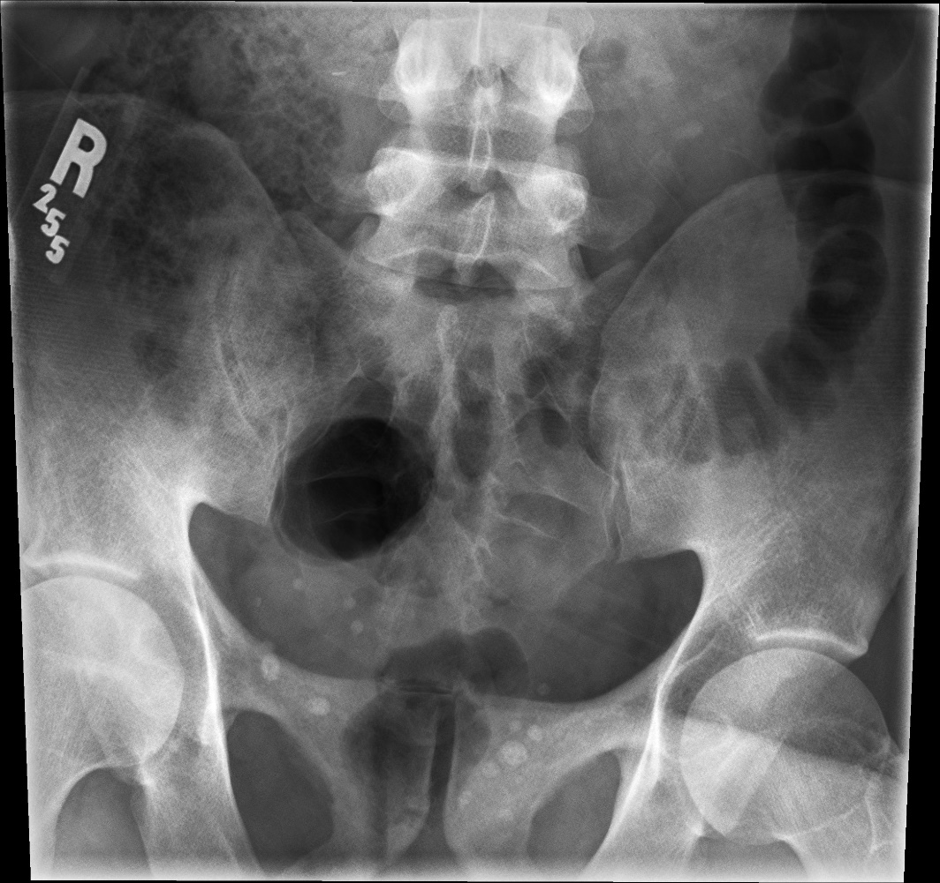
Answer 1000 Points
Nothing.
Don’t order tests that don’t change management – Walter Huda, PhD
Liwei Jiang, Brigham and Women’s Hospital
Notes:
MRN 24963944. Fell off bike.

Slide 120
Tie-Breaker Final Jeopardy

Slide 121
Final Jeopardy
What test has the highest sensitivity and specificity in diagnosing acute cholecystitis

Slide 122
Answer Final Jeopardy
Nuclear medicine biliary scan
(HIDA)
Tie Breaker
End

Slide 123
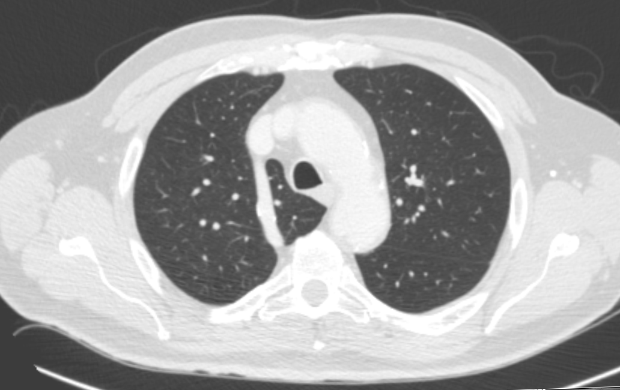
Tie-Breaker Final Jeopardy
What is this? (be specific)
Commons.wikimedia.org

Slide 124
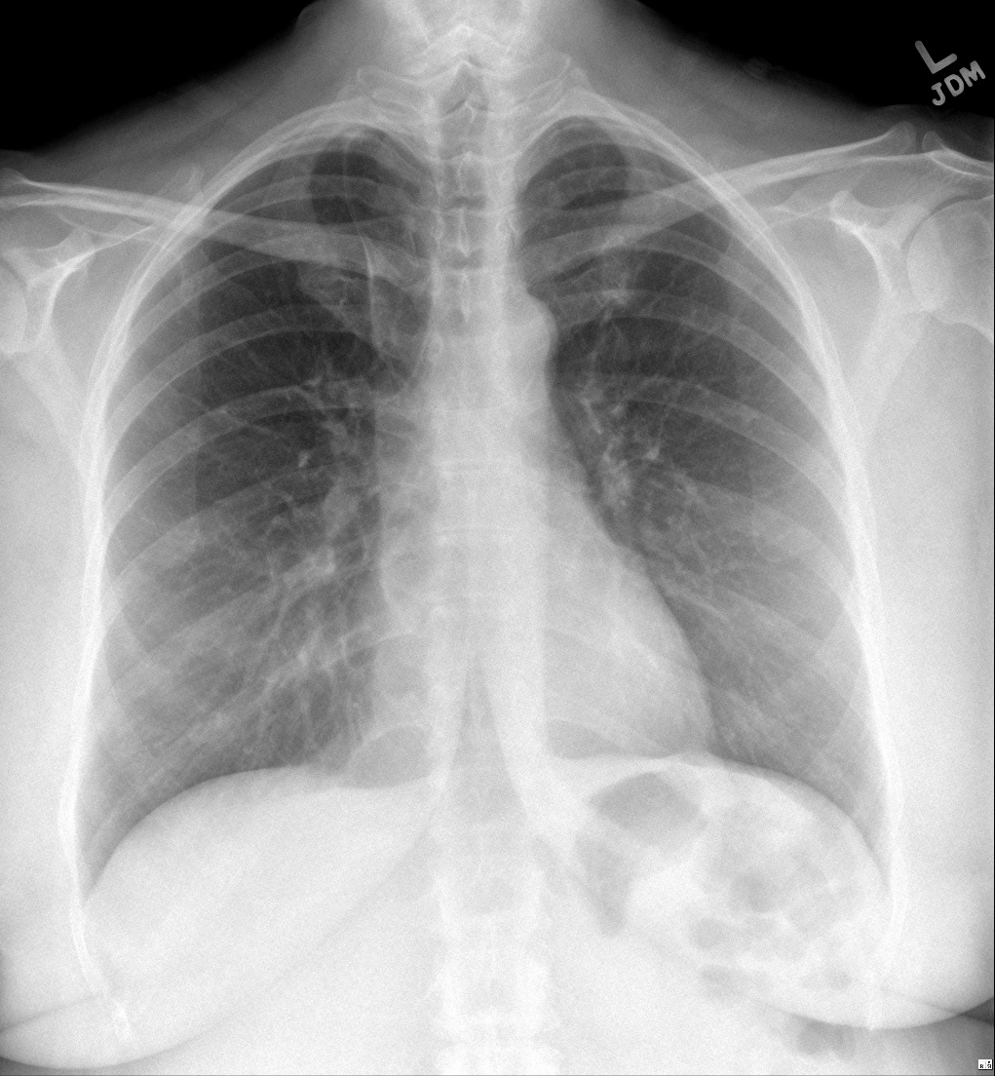
Answer Final Jeopardy
Azygos Lobe
Liwei Jiang, Brigham and Women’s Hospital

Slide 125
Daily Double

