Slide 1
Radiology Anatomy Jeopardy
Shanna Matalon, PGY-5

Slide 2
The Rules

Slide 3
Teams of at least 2 students will compete
If you wish to take a question, raise your hand
Do not raise your hand until you think you know the answer!!
Answers can then be discussed between team members
You have 10 seconds to answer before the next team is offered the question.

Slide 4
If you pass a question or give an incorrect answer then the other two groups have a chance to answer
Points are deducted for passing after raising your hand or answering the question wrong
Whoever gives the correct answer controls the board
BIG money prizes to the winning team…

Slide 5
Shanna’s decision is final
(even if wrong)

Slide 6
Radiology Jeopardy
Chest
200
Abdomen & pelvis
MSK
300
400
500
100
200
300
400
500
100
200
300
400
500
Neuro
100
200
300
400
500
100
Notes:
Change these headings to any you wish, also change heading slides 11,33,55,77,99 to match to save confusion

Slide 7
Double Jeopardy
Chest
400
Abdomen & pelvis
MSK
600
800
1000
200
400
600
800
1000
200
400
600
800
1000
Neuro
200
400
600
800
1000
200
Notes:
Change these headings to any you wish, they can be different from the prior categories, also change heading slides 22,44,66,88,110 to match to save confusion

Slide 8
Final Jeopardy

Slide 9
Chest
Notes:
Or other category of your wish for single jeopardy

Slide 10
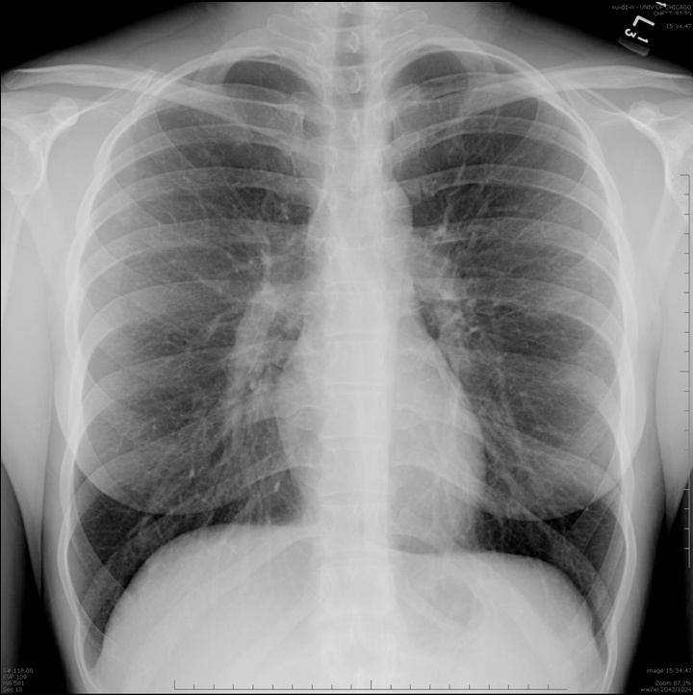
100 Points
What is this structure?
Image courtesy of Christopher Straus, M.D.

Slide 11
Answer 100 Points
The carina.
Image Credit: AMSER

Slide 12
200 Points
What structure forms this contour on the frontal chest xray?
Image courtesy of Christopher Straus, M.D.

Slide 13
Answer 200 Points
The aortic arch.
Image Credit: AMSER
Notes:
Image Credit: AMSER

Slide 14
300 Points
Which cardiac chamber makes up this heart border?

Slide 15
Answer 300 Points
The right atrium.
anterior
RV
LV
right
RA
left
LA
posterior

Slide 16
400 Points
Name this structure.

Slide 17
Answer 400 Points
The right main pulmonary artery.

Slide 18
500 Points
Name these structures.

Slide 19
Answer 500 Points
Spinous processes.

Slide 20
Chest double jeopardy
Notes:
Or other category of your wish for double jeopardy

Slide 21
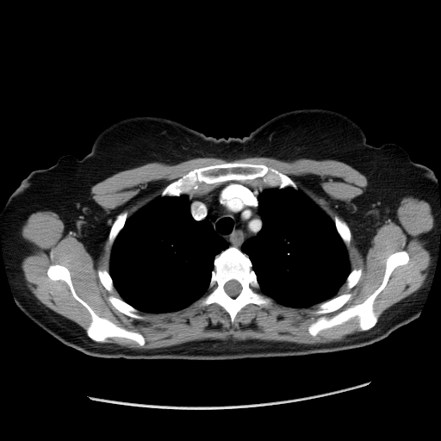
200 Points
Name this structure.
Image Credit: AMSER

Slide 22
Answer 200 Points
The superior vena cava (SVC).

Slide 23
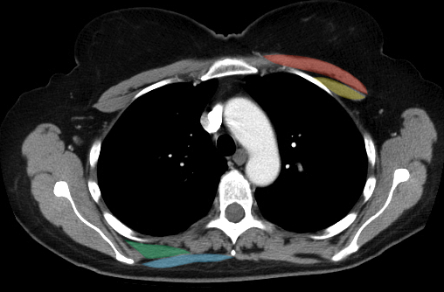
400 Points
Name these structures.
Image Credit: AMSER

Slide 24
Answer 400 Points
Pectoralis major and minor.

Slide 25
600 Points
An endotracheal tube should terminate 3-5 cm above THIS structure.

Slide 26
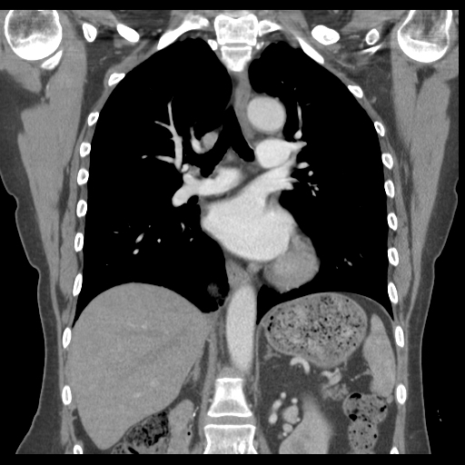
Answer 600 Points
The carina.
Image Credit: AMSER

Slide 27
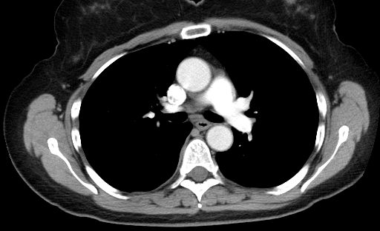
800 Points
Name this structure.

Slide 28
Answer 800 Points
The esophagus.

Slide 29
1000 Points
Name these 3 structures in correct order.

Slide 30
Answer 1000 Points
brachiocephalic artery
left common carotid artery
left subclavian artery

Slide 31
Abdomen & Pelvis
Notes:
Or other category of your wish for single jeopardy

Slide 32
100 Points
What does KUB stand for?

Slide 33
Answer 100 points
Kidneys, Ureter, Bladder.

Slide 34
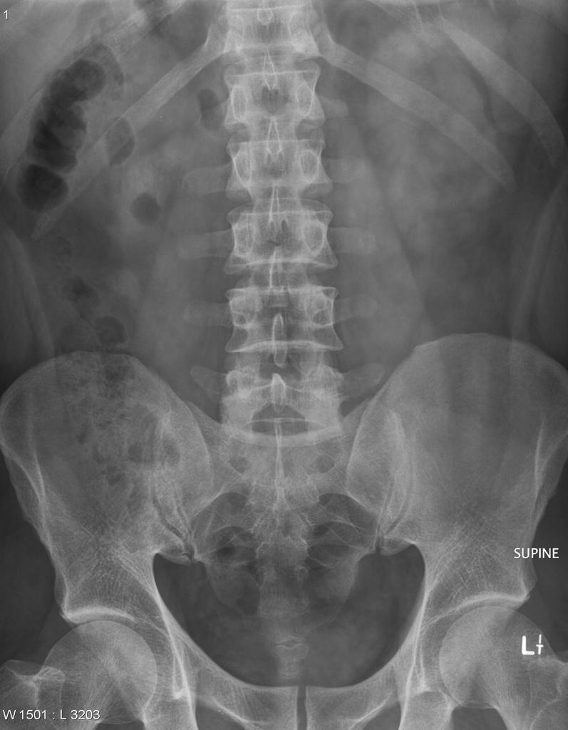
200 Points
What is the source of this shadow?
Image credit: Radiopaedia

Slide 35
Answer 200 points
The left kidney.

Slide 36
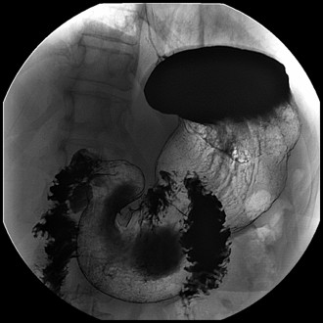
300 Points
What is this part of the stomach?

Slide 37
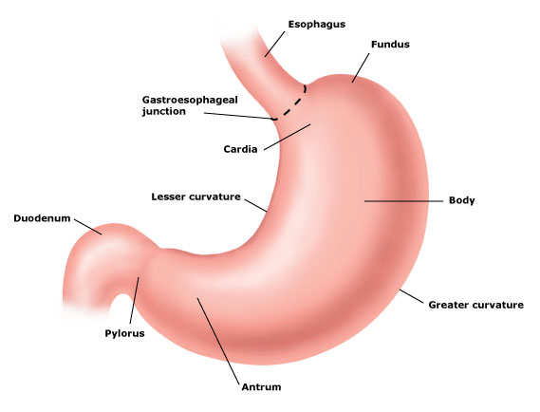
Answer 300 points
The fundus.

Slide 38
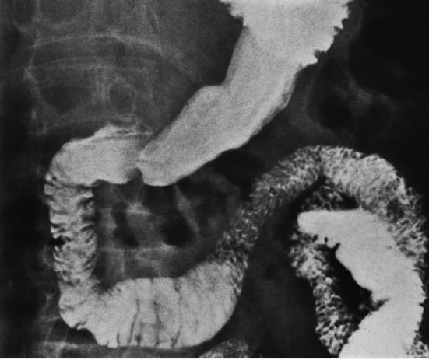
400 Points
Which structure that is nestled into this space?
Image credit: Phillips et al.

Slide 39
Answer 400 points
The pancreas.

Slide 40
500 Points
Which portion of the duodenum can be obstructed in SMA syndrome?

Slide 41
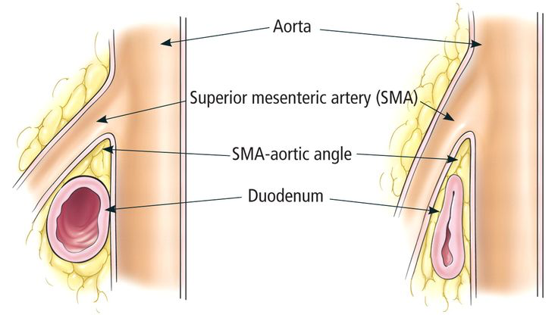
Answer 500 points
The horizontal (3rd) part.
Image credit: Dr. Google

Slide 42
Abdomen double jeopardy
Notes:
Or other category of your wish for double jeopardy

Slide 43
200 Points
What is the location of this gas?
200 bonus points: What is the diagnosis?

Slide 44
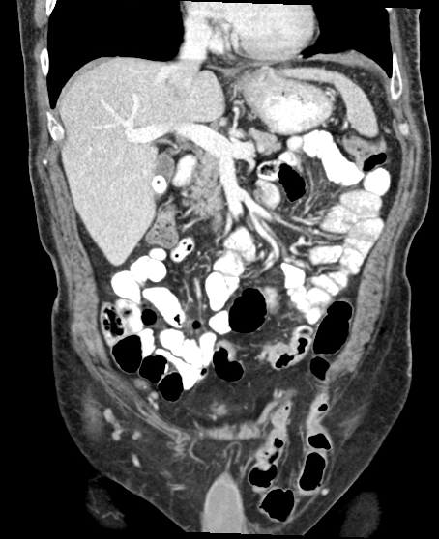
Answer 200 Points
The left scrotum.
Left inguinal hernia containing bowel!

Slide 45
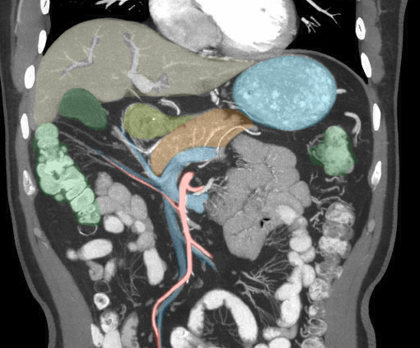
400 Points
Identify these structures (blue and red).

Slide 46
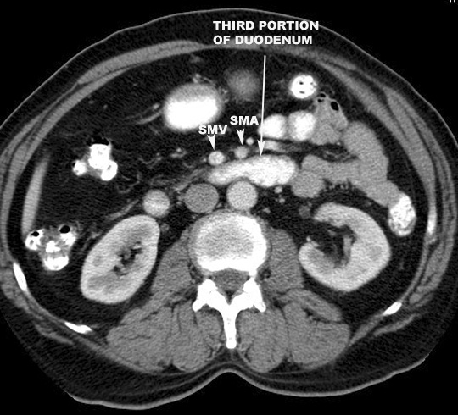
Answer 400 Points
SMV & SMA.
Blue = SMV
Red = SMA

Slide 47
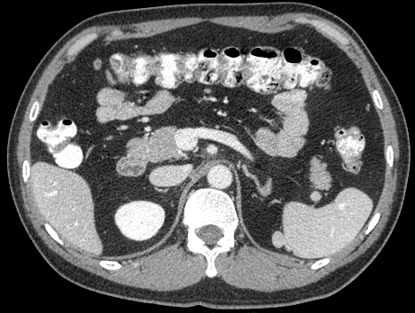
600 Points
What is this structure?

Slide 48
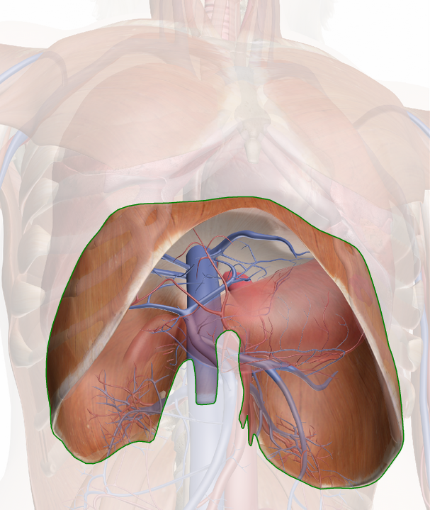
Answer 600 Points
The diaphragmatic crura.

Slide 49
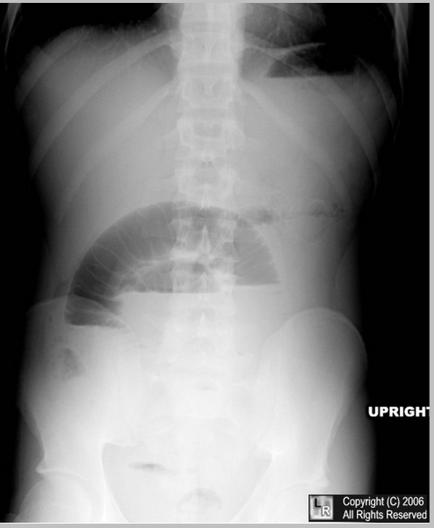
800 Points
Which bowel is involved in this process
(small or large)?

Slide 50
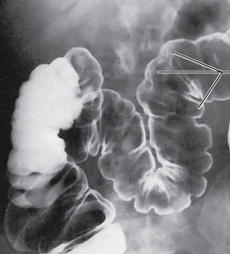
Answer 800 Points
Small bowel.
Valvulae conniventes/plicae circularis vs haustra

Slide 51
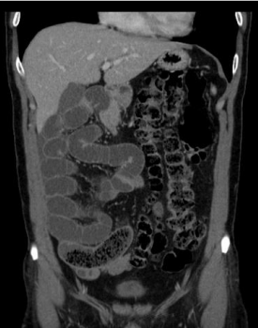
1000 Points
What is the abnormality seen here.

Slide 52
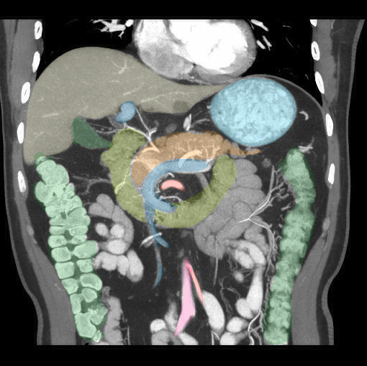
Answer 1000 Points
Intestinal malrotation.
-small bowel on the right, colon on the left
-normally, small bowel central, colon goes up and around

Slide 53
MSK
Notes:
Or other category of your wish for single jeopardy

Slide 54
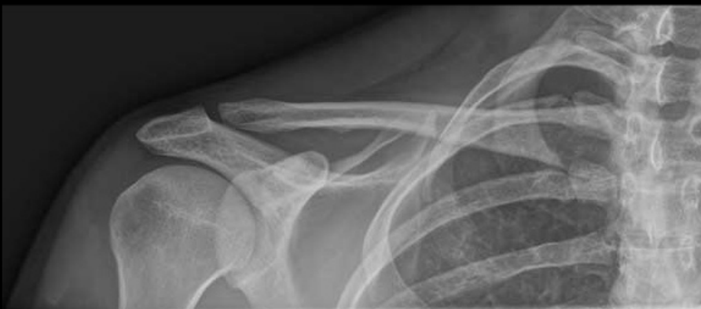
100 Points
The name of this joint.
Image credit: IMAIOS e-anatomy

Slide 55
Answer 100 Points
The acromioclavicular joint

Slide 56
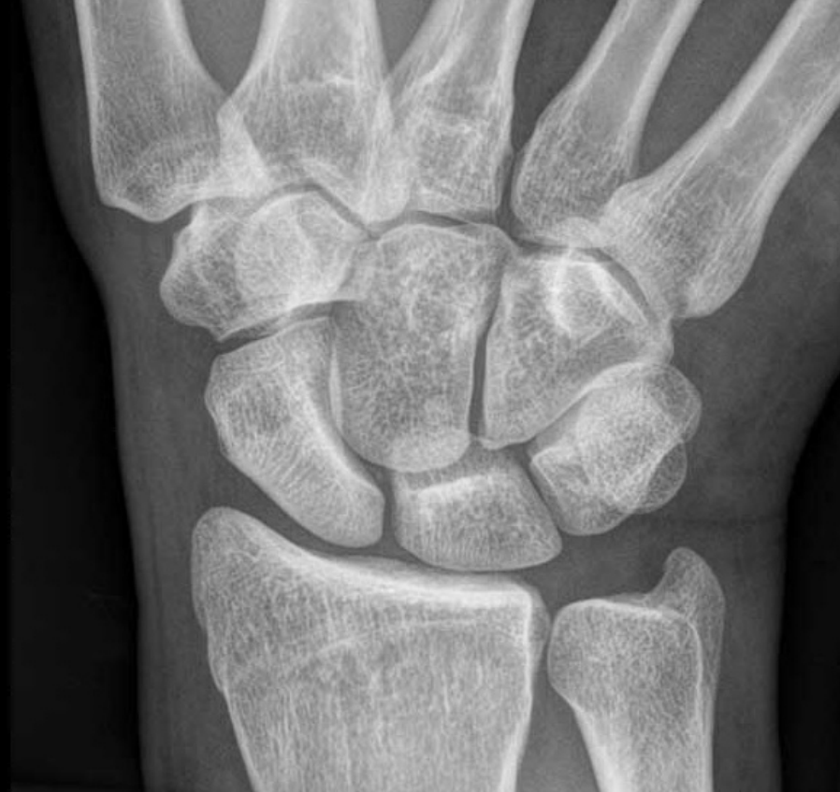
200 Points
Name these bones.
B
A
Image credit: IMAIOS e-anatomy

Slide 57
Answer 200 Points
Radius (A) and ulna (B)
A
B

Slide 58
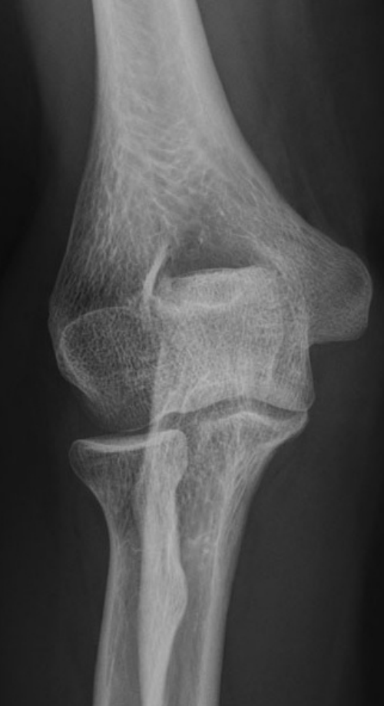
300 Points
Name this structure (be specific!)
Image credit: IMAIOS e-anatomy

Slide 59
Answer 300 points
The medial epicondyle

Slide 60
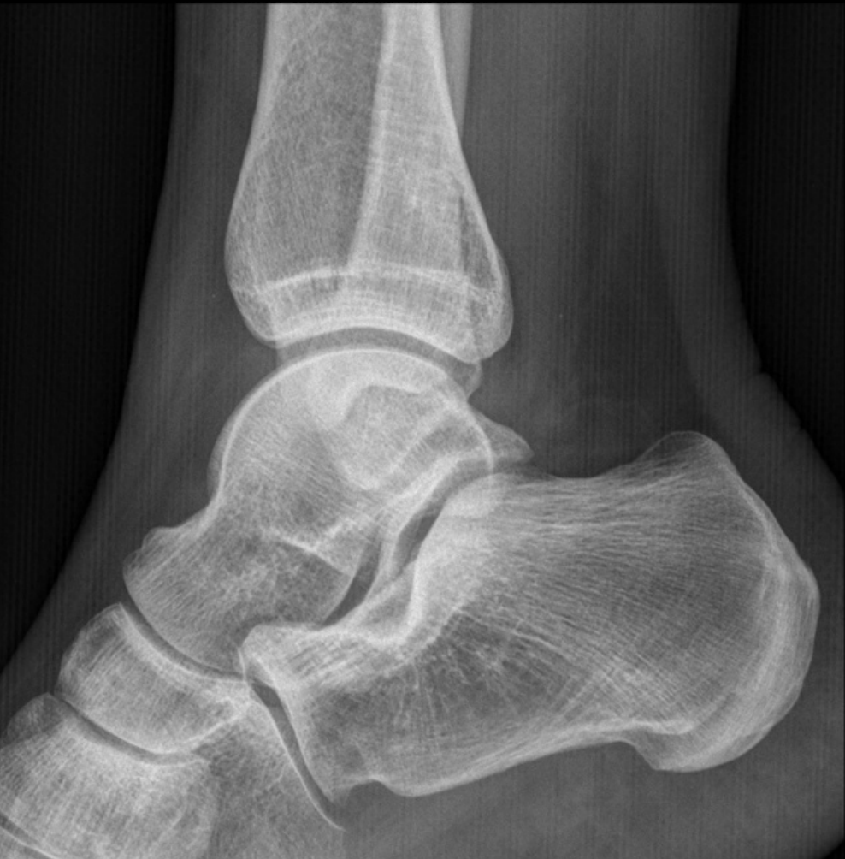
400 Points
Name this structure
Image credit: IMAIOS e-anatomy

Slide 61
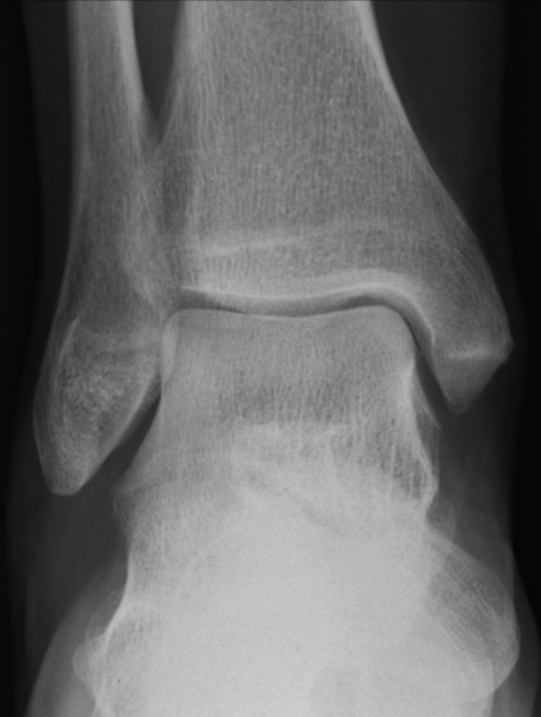
Answer 400 Points
The talus
Image credit: IMAIOS e-anatomy

Slide 62
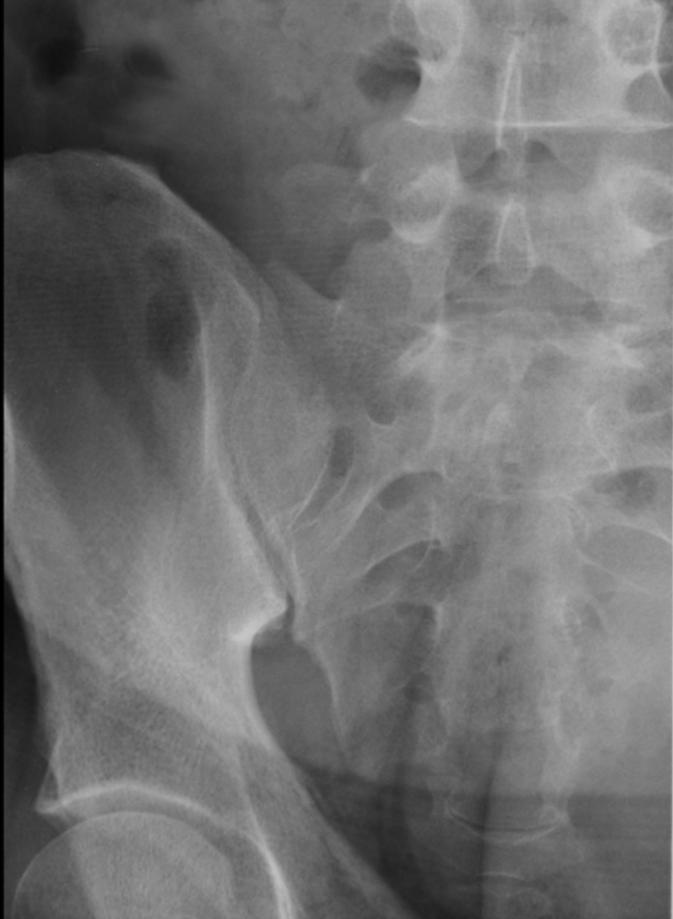
500 POINTS
Name two diseases that affects this joint.
Image credit: IMAIOS e-anatomy

Slide 63
Answer 500 Points
Ankylosing spondylitis
Psoriatic arthritis
IBD associated sacroiliitis
Septic joint
Osteoarthritis
Rheumatoid arthritis

Slide 64
MSK Double Jeopardy
Notes:
Or other category of your wish for double jeopardy

Slide 65
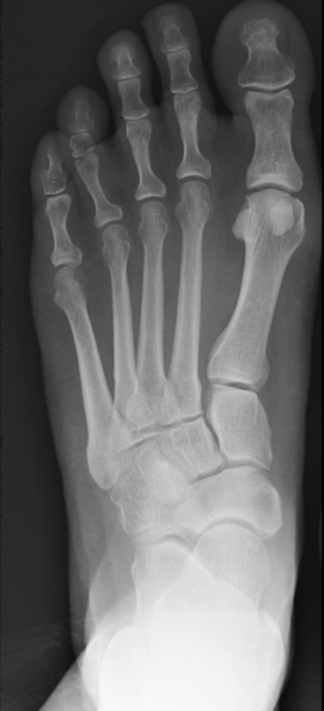
200 Points
Which joint is most likely to be affected by gout?
Image credit: IMAIOS e-anatomy

Slide 66
Answer 200 Points
The first MTP joint.
Image credit: IMAIOS e-anatomy

Slide 67
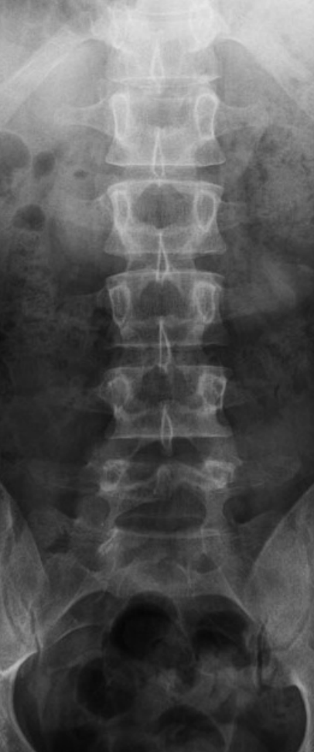
400 Points
This structure.
Image credit: IMAIOS e-anatomy

Slide 68
Answer 400 Points
The transverse process.

Slide 69
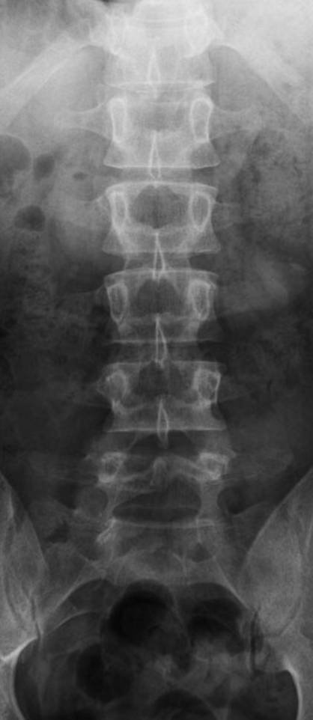
600 Points
This structure.
Image credit: IMAIOS e-anatomy

Slide 70
Answer 600 Points
The pedicle.

Slide 71
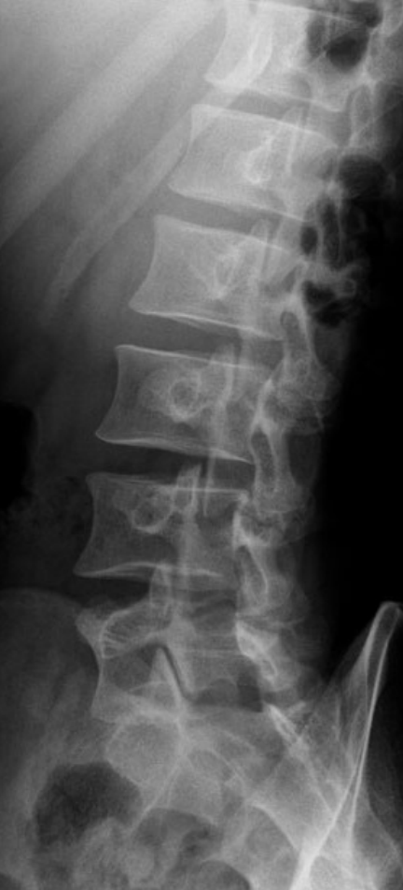
800 Points
What is the position in which this film was taken?
Bonus 200 points: Name this structure.
Image credit: IMAIOS e-anatomy

Slide 72
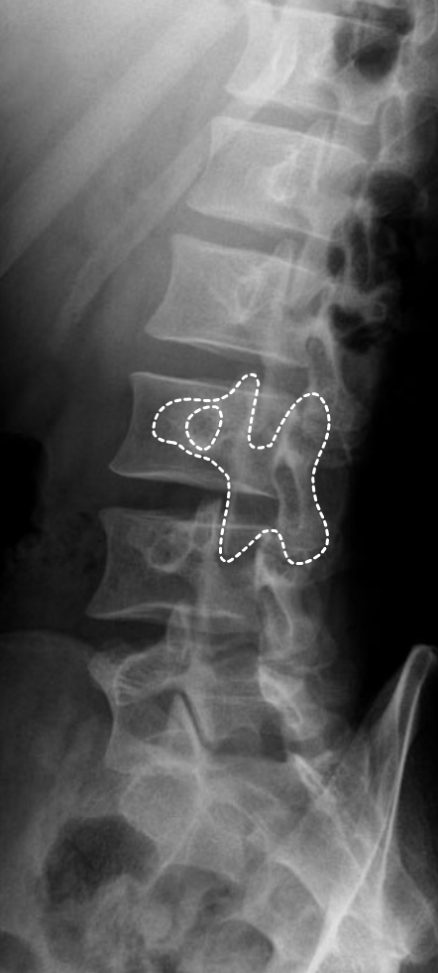
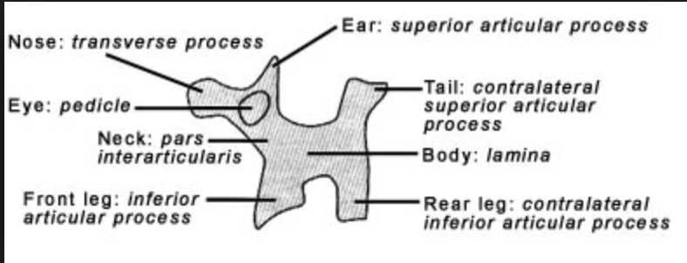
Answer 800 Points
1) Lateral oblique
2) Pars interarticularis
Image credit: IMAIOS e-anatomy

Slide 73
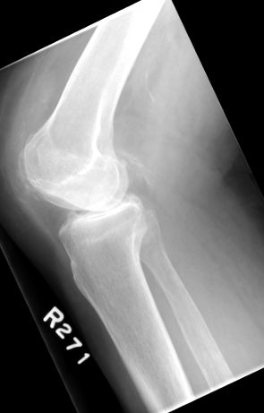
1000 Points
The abnormality seen here.
Image credit: Lewis et al.

Slide 74
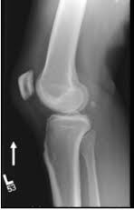
Answer 1000 Points
Absent patella!

Slide 75
Neuro
Notes:
Or other category of your wish for single jeopardy

Slide 76
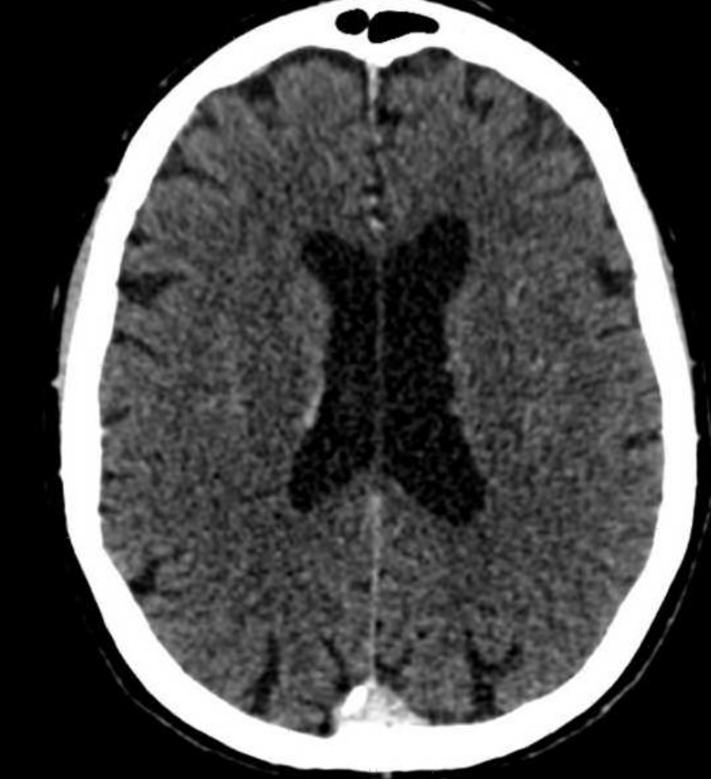
100 Points
This structure.
Image credit: IMAIOS e-anatomy

Slide 77
Answer 100 Points
The right lateral ventricle.

Slide 78
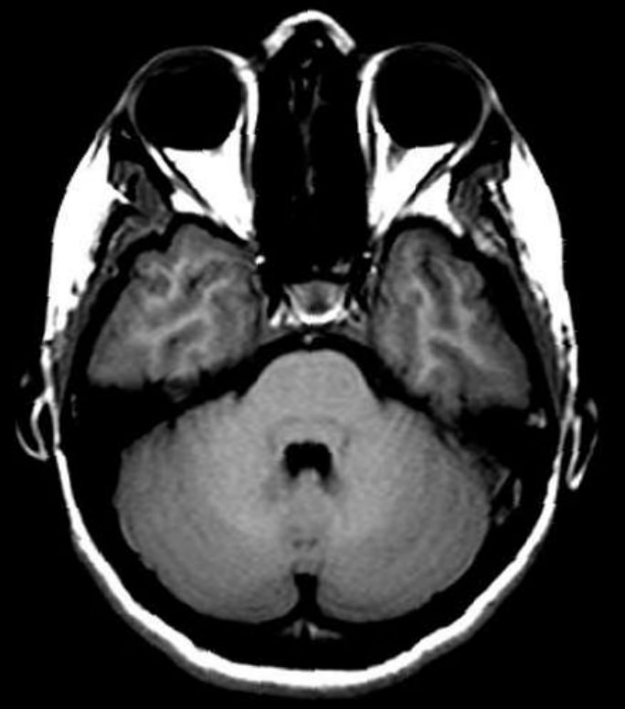
200 Points
What is this structure?
Image credit: IMAIOS e-anatomy

Slide 79
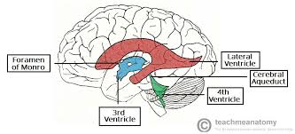
Answer 200 Points
The 4th ventricle.

Slide 80
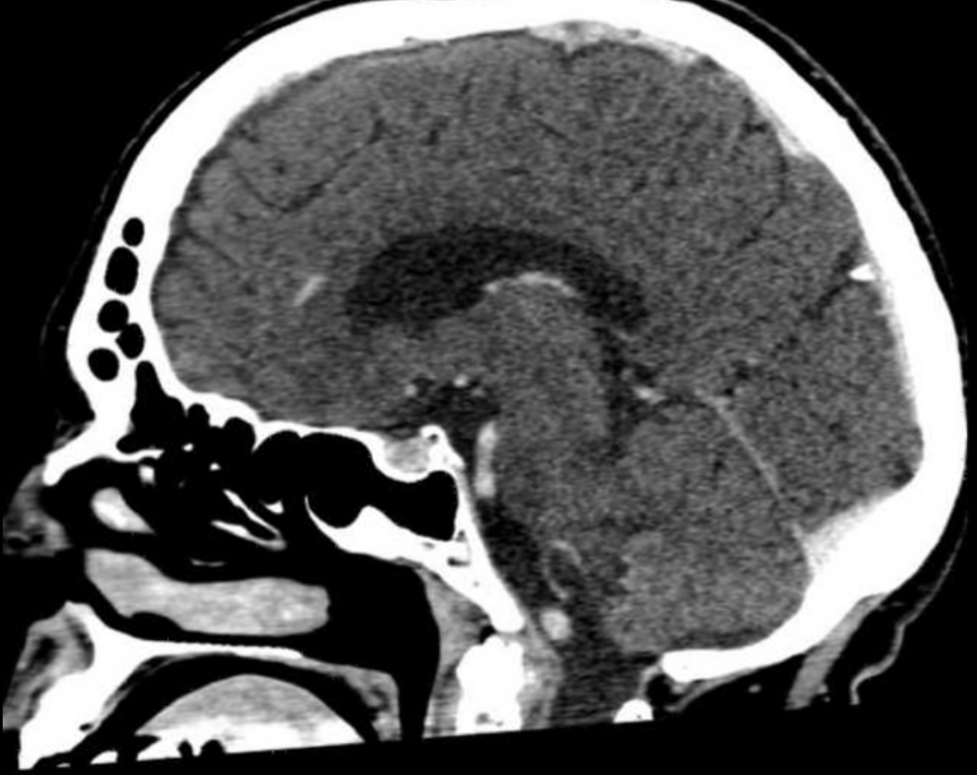
300 Points
What is this structure?

Slide 81
Answer 300 Points
The cerebellum.

Slide 82
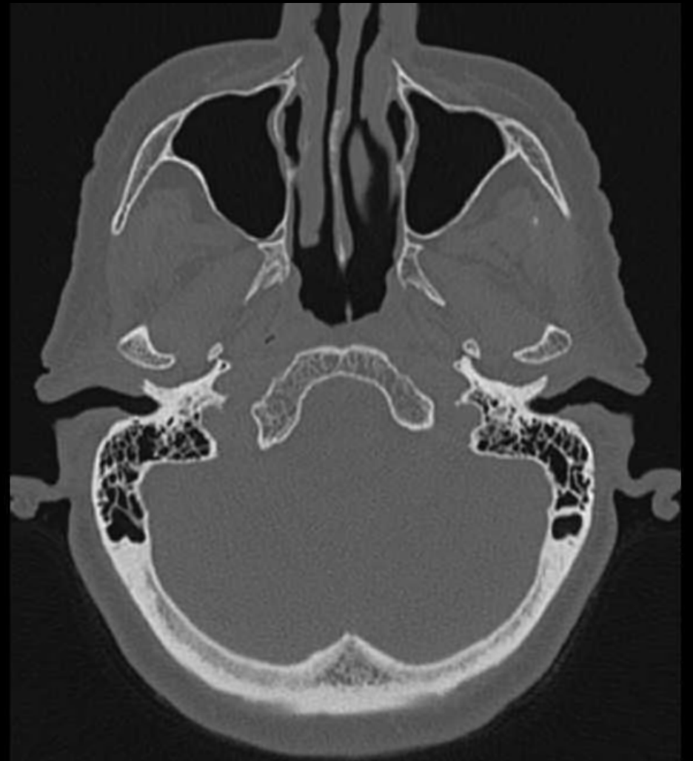
400 Points
What are these structures?

Slide 83
Answer 400 points
Maxillary sinuses.

Slide 84
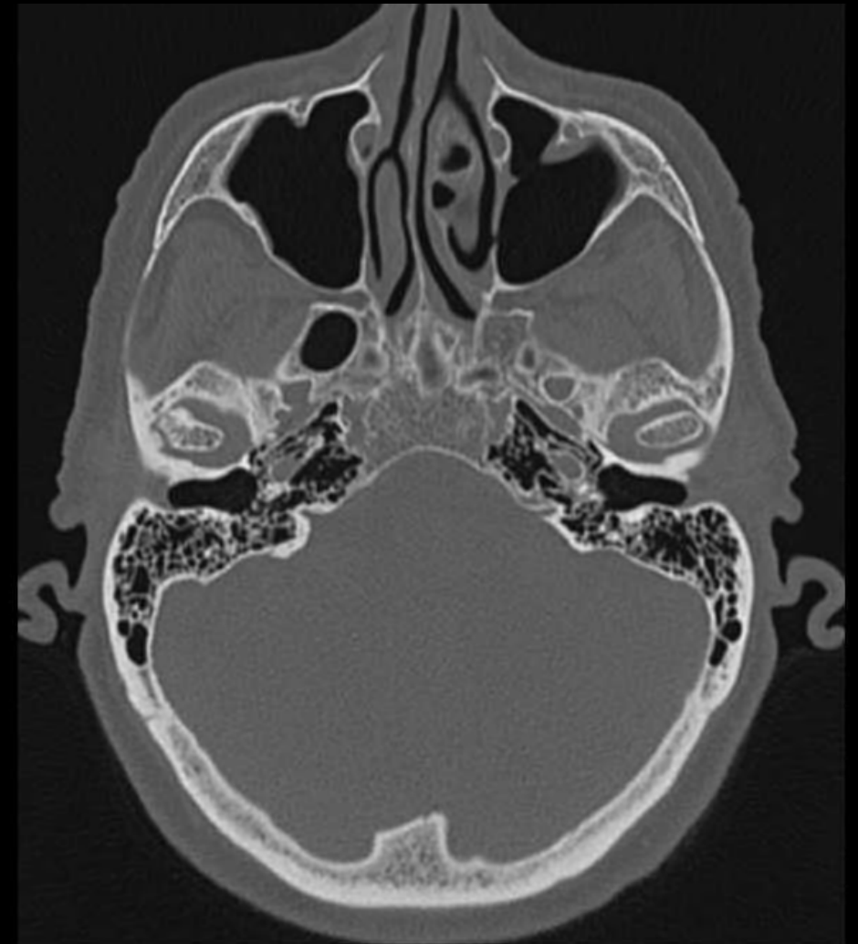
500 Points
What is the name of these structures?

Slide 85
Answer 500 Points
Mastoid air cells.

Slide 86
Neuro Double Jeopardy
Notes:
Or other category of your wish for double jeopardy

Slide 87
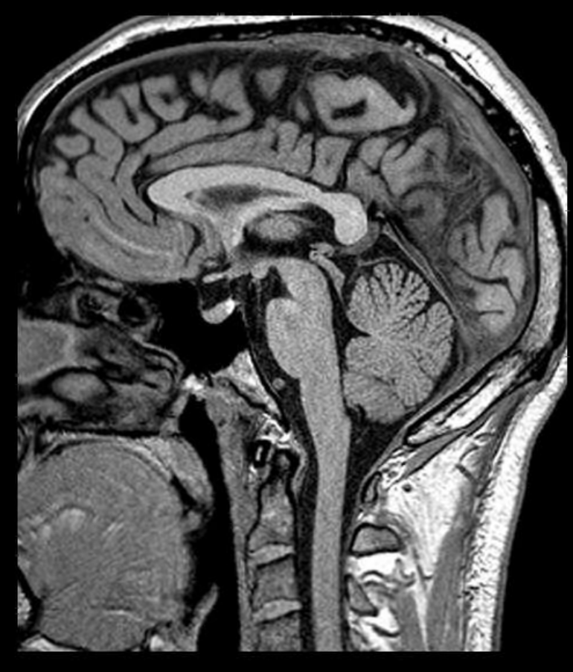
200 Points
What is this structure?

Slide 88
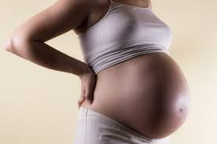
Answer 200 Points
The pons.

Slide 89
400 Points
What is this structure?
For 400 bonus points, list 1 pathology that can involve this structure.

Slide 90
Answer 400 points
The corpus callosum.
Glioblastoma multiforme, lymphoma, multiple sclerosis, agenesis of the corpus callosum (congenital)

Slide 91
600 Points
Name 3 hormones made here.

Slide 92
Answer 600 Points
Anterior – FSH, LH, ADH, TSH, HGH, ACTH, prolactin
Posterior – ADH, oxytocin

Slide 93
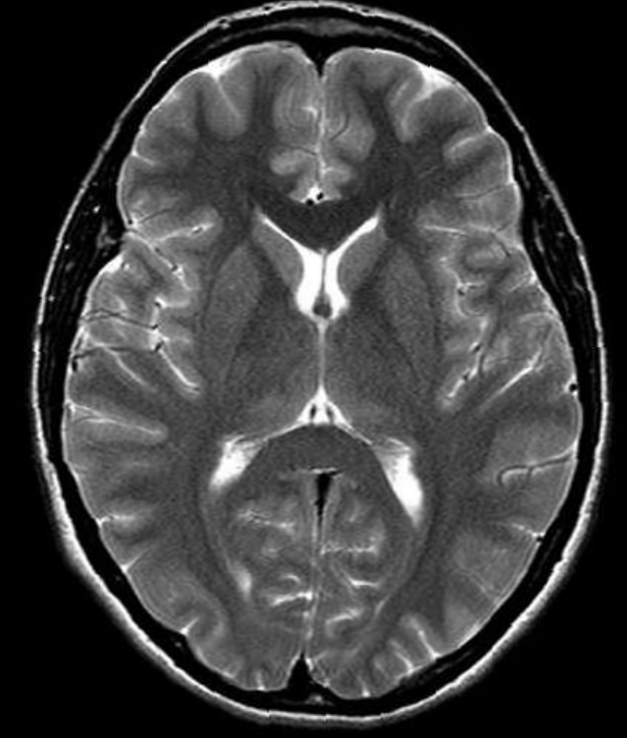
800 Points
What are these structures referred to as?

Slide 94
Answer 800 Points
The basal ganglia.

Slide 95
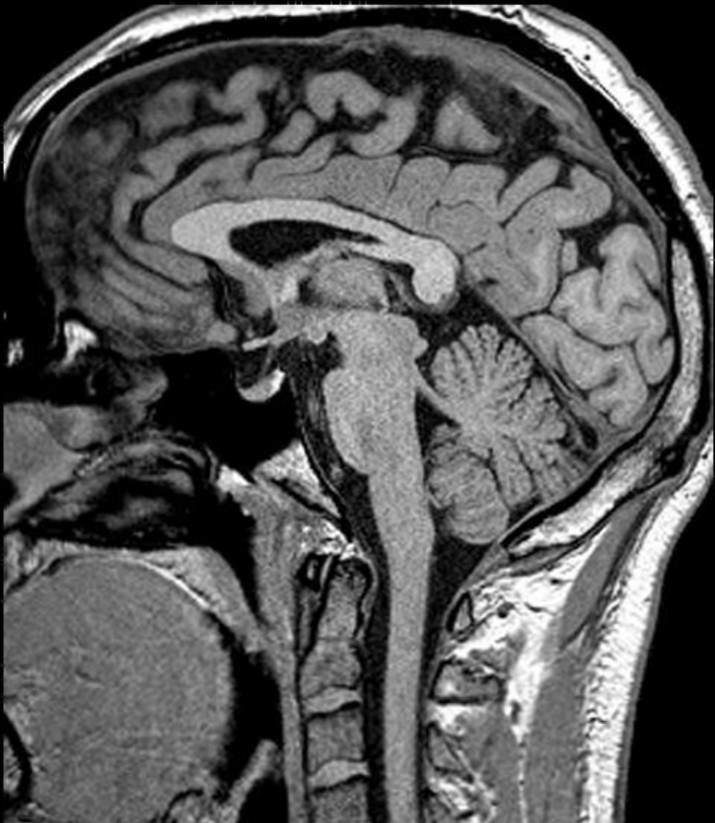
1000 Points
What is the name of this structure?

Slide 96
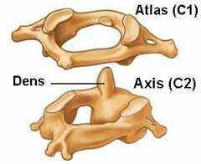
Answer 1000 Points
The dens, aka axis.

Slide 97
Final Jeopardy

Slide 98
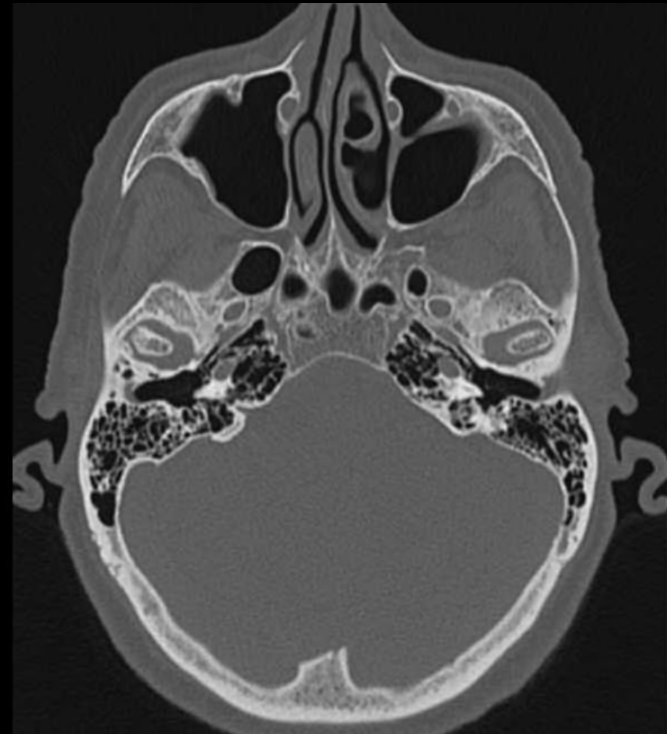
Final Jeopardy
Name these structures.

Slide 99
Answer Final Jeopardy
Temporomandibular joint.

Slide 100
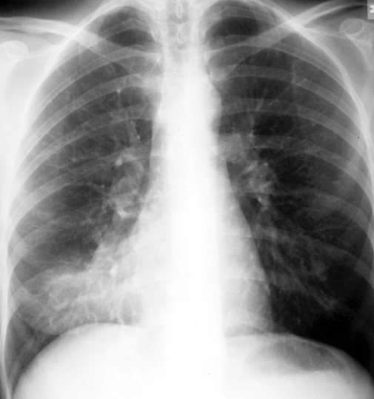
Final Jeopardy
In which lobe is this pneumonia located (be specific)?
Case courtesy of A.Prof Frank Gaillard, Radiopaedia.org

Slide 101
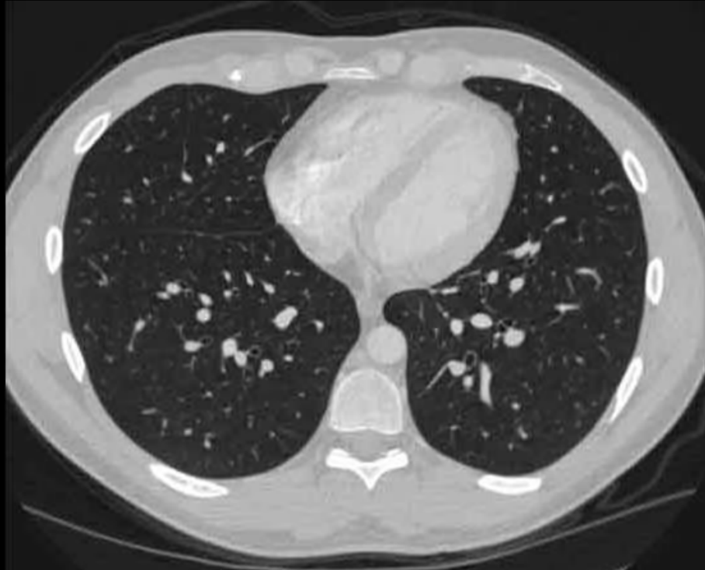
Answer Final Jeopardy
Right middle lobe (medial segment)
RML
Lingula
RLL
LLL

Slide 102
Daily Double

Slide 103
Daily double
Name these structures.

Slide 104
Daily double answer
Spinous processes.

